Slide 1
Just say no to the ‘just-in-case’ cannula.

Slide 2
Cannulation pack & IV trolley design
INDEX

Slide 3
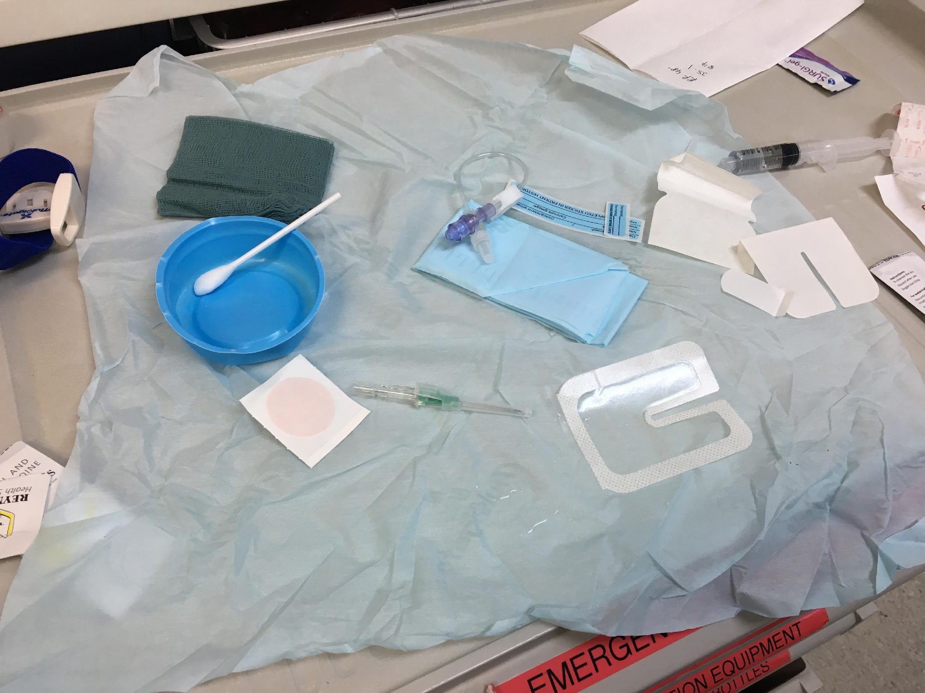
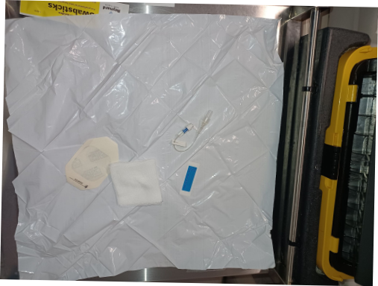
Cannulation Packs
Improved & simplified pack
Pack improvements
Use a more secure dressing than Tegaderm (e.g., IV3000)
A different brand of swab stick
Include a positive-pressure J-loop
Items to be added by staff
tourniquet
10ml syringe and saline amp
chosen cannula
Old Pack
With elements of sterile and non-sterile items all intermixed together

Slide 4
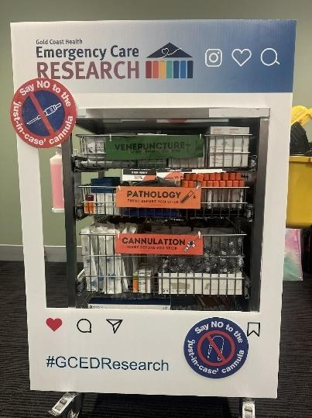
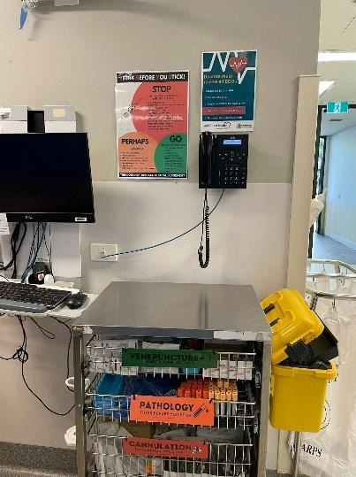
Change of the IV trolley
Visual Reminder
Placing venepuncture at the top of the trolley serves as a clear, immediate prompt for staff to consider it first.
Increased Accessibility
By positioning venepuncture supplies at the front, it becomes the most accessible option, reducing the impulse to cannulation.
Encourages Best Practice
Reinforces the idea that venepuncture is the preferred first step, promoting a shift in clinical habits.
Minimises Unnecessary Cannulation
Reduces the tendency to use PIVCs 'just in case' by highlighting venepuncture as a simpler, less invasive first-line approach.

Slide 5
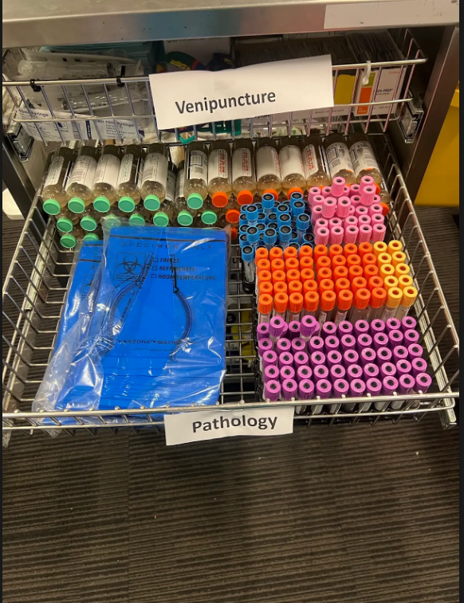
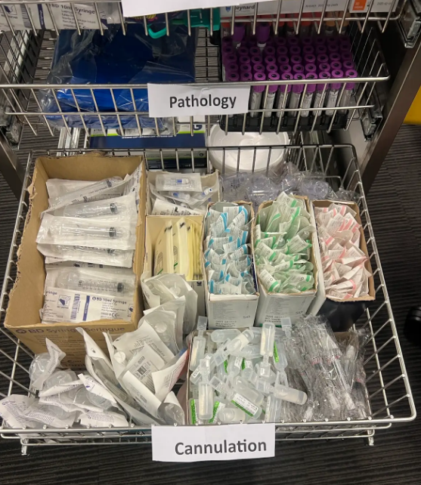
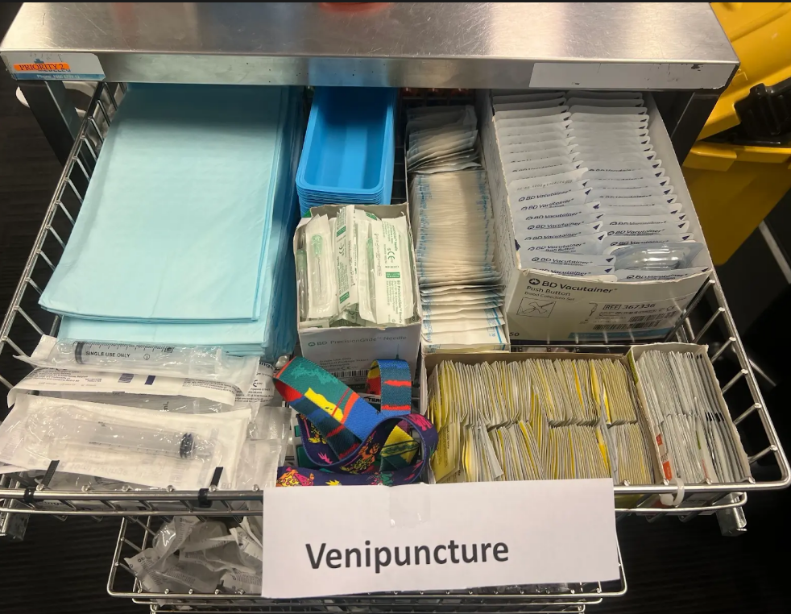

Slide 6


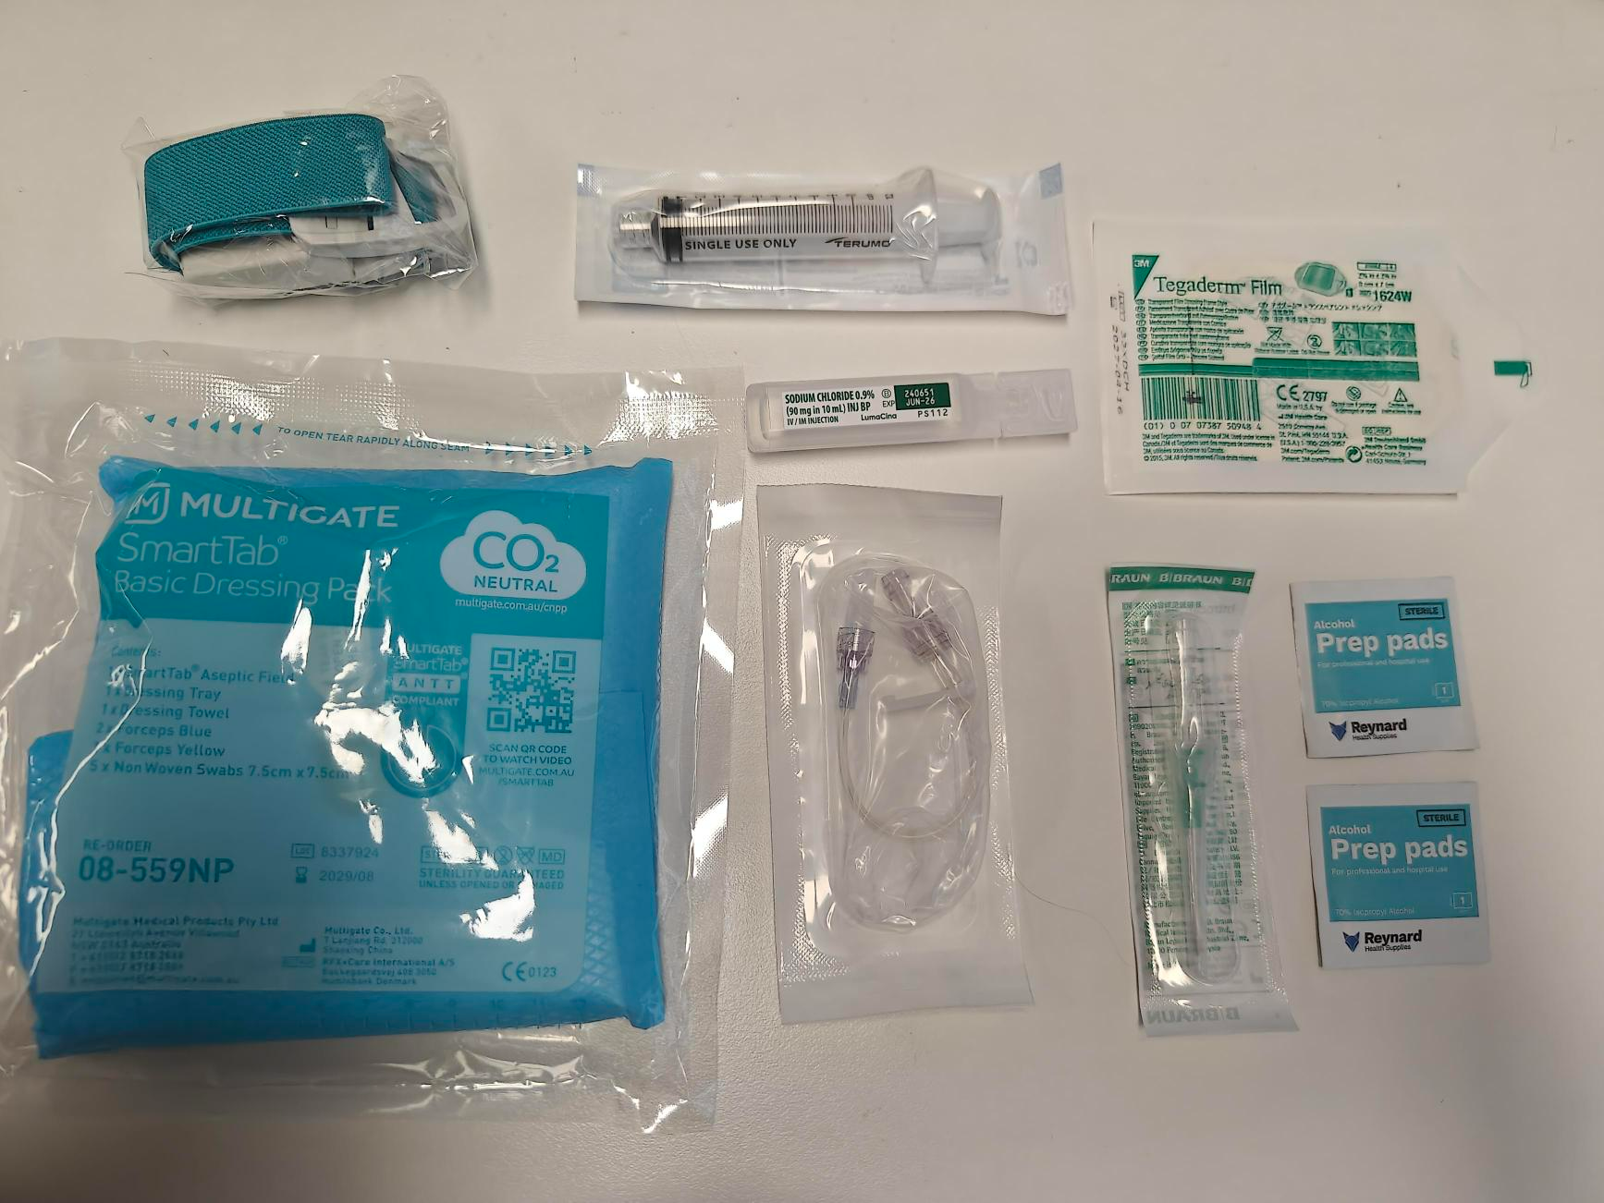
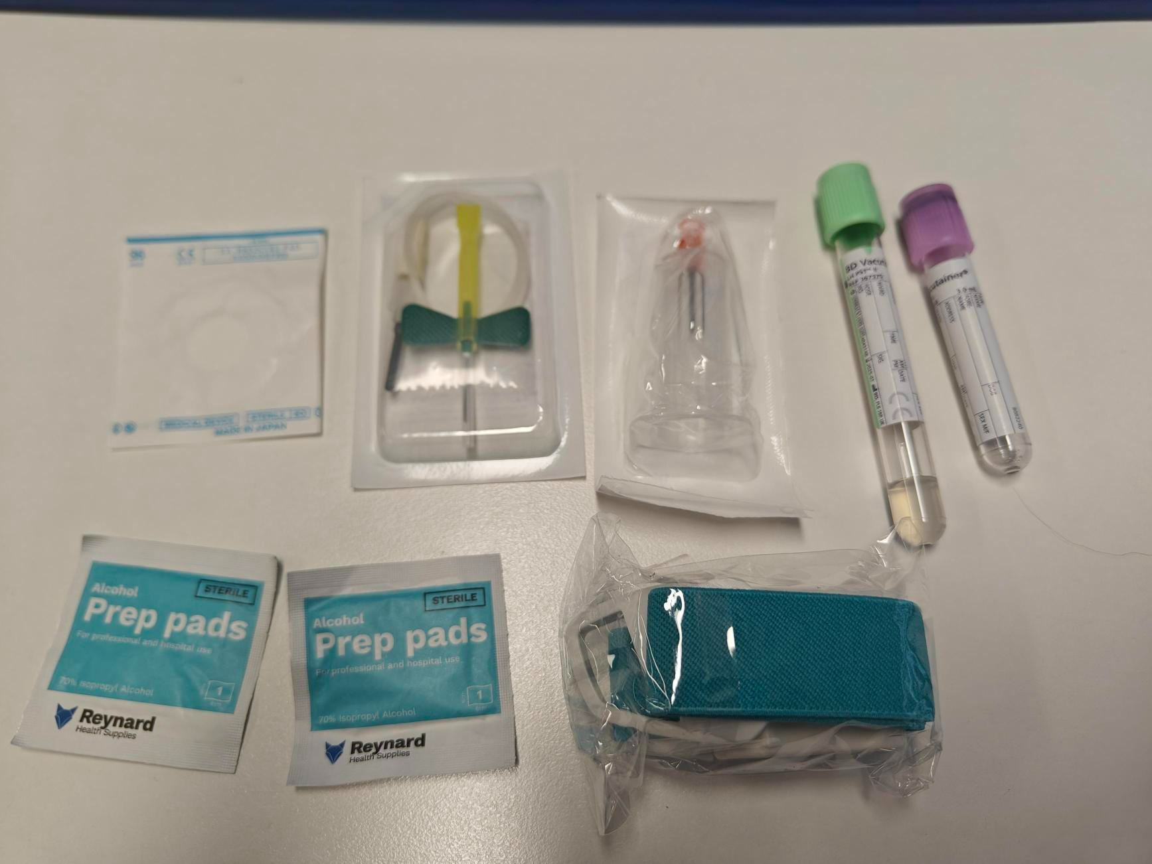
PIVC insertion vs Venepuncture
AU$5.21
AU$2.35
x2

