Slide 1

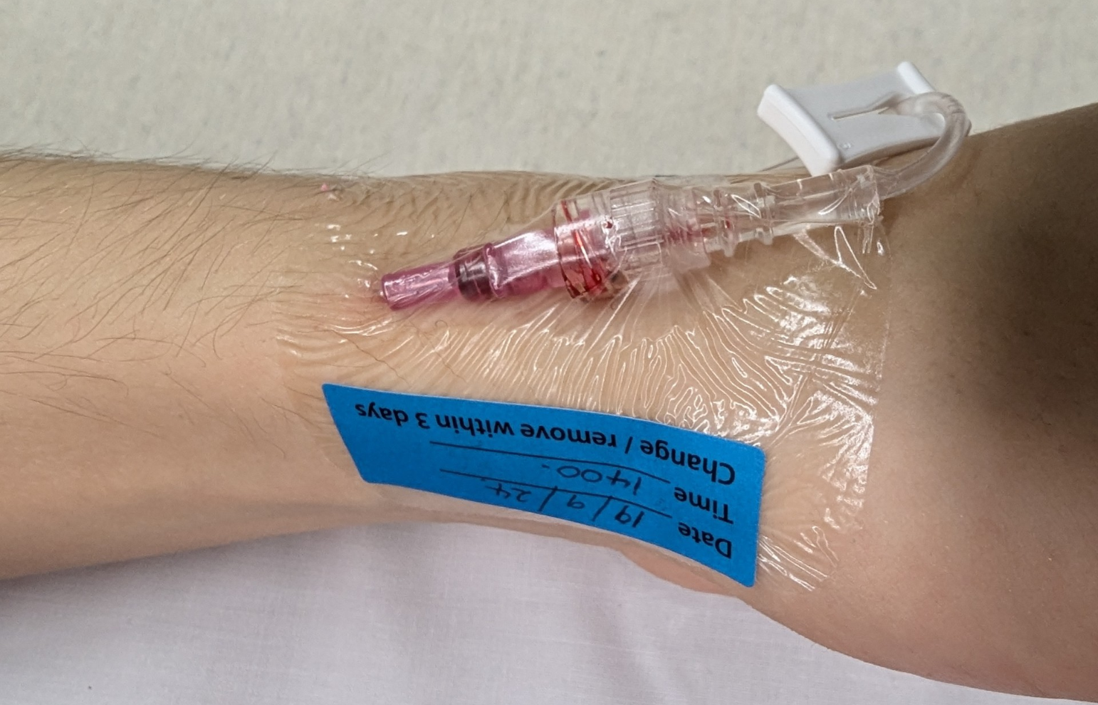
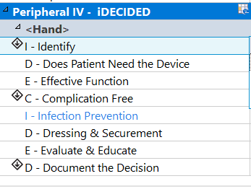
What constitutes a good cannula?
Cannula situated in an area of non-flexion
Dry, intact, semi-permeable dressing in situ
Insertion date & time recorded on dressing
IV extension secured with tape
Completed iDECIDED documentation on EMR
1
1
2
2
3
3
4
5
5

