Slide 1
Just say no to the ‘just-in-case’ cannula.

Slide 2
DOCUMENTATION OF PIVC
To reflect the implementation of iDECIDED within the electronic medical record (EMR) system
INDEX

Slide 3
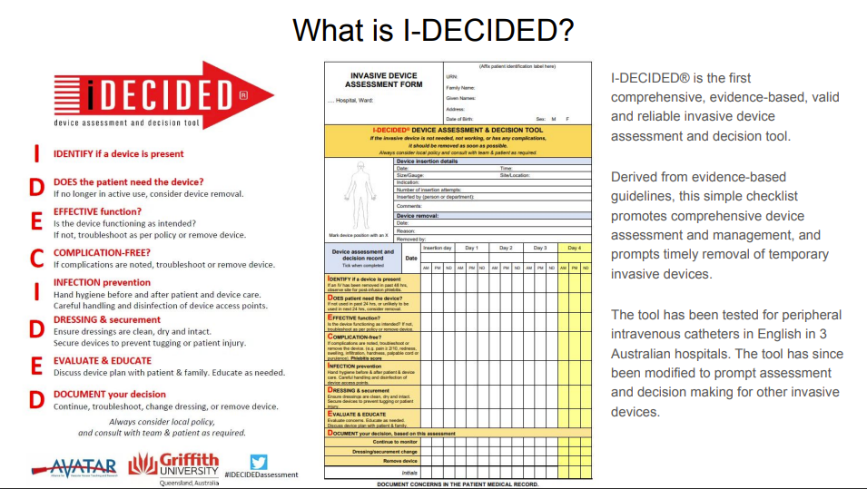
BACKGROUND
https://www.avatargroup.org.au/i-decided.html

Slide 4
WHAT HAS NOT CHANGED – POLICIES & PROCEDURES
Peripheral Intravenous Cannula (PIVC) Insertion, Assessment and Management (Adult)
Peripheral intravenous (IV) device insertion and management (Paediatrics)
Peripheral Intravenous Catheter Insertion and Management (Neonatal)

Slide 5
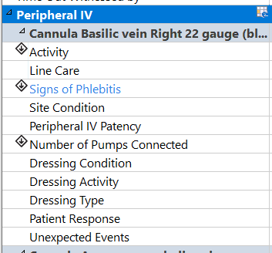
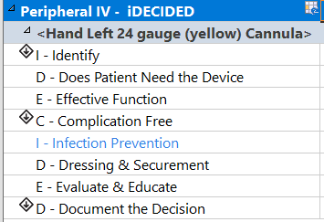
WHAT HAS CHANGED – DOCUMENTATION IN EMR
Streamlined, simplified
Utilising evidence-based tool
OLD
Peripheral IV
Peripheral IV - iDECIDED
NEW

Slide 6
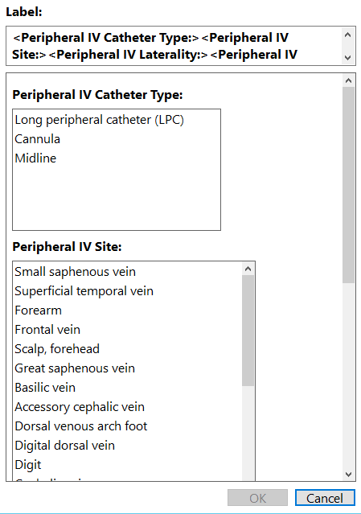
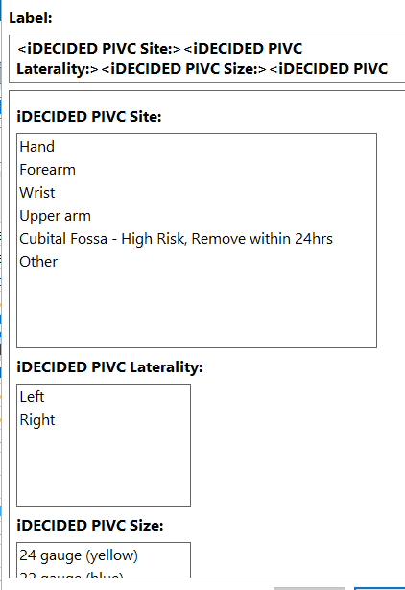
WHAT HAS CHANGED – DYNAMIC GROUP LABEL
Peripheral IV
Peripheral IV - iDECIDED

Slide 7
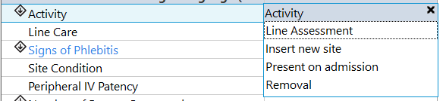
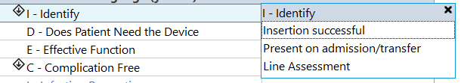
WHAT HAS CHANGED – ACTIVITY > IDENTIFY
Peripheral IV
Peripheral IV - iDECIDED

Slide 8
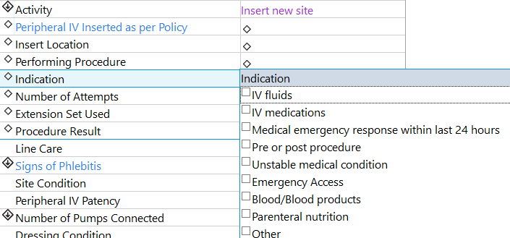
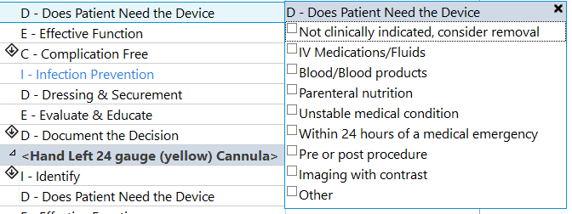
WHAT HAS CHANGED – INDICATION > DOES PATIENT NEED THE DEVICE
Peripheral IV
Peripheral IV - iDECIDED

Slide 9
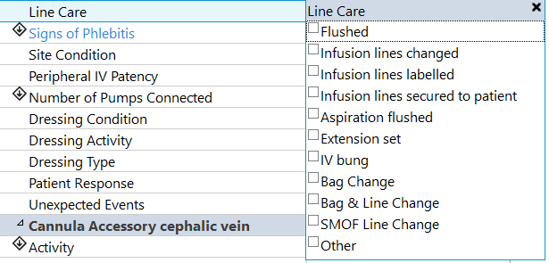
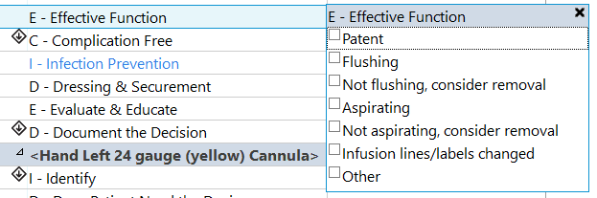

WHAT HAS CHANGED –
LINE CARE > EFFECTIVE FUNCTION
Peripheral IV
Peripheral IV - iDECIDED

Slide 10
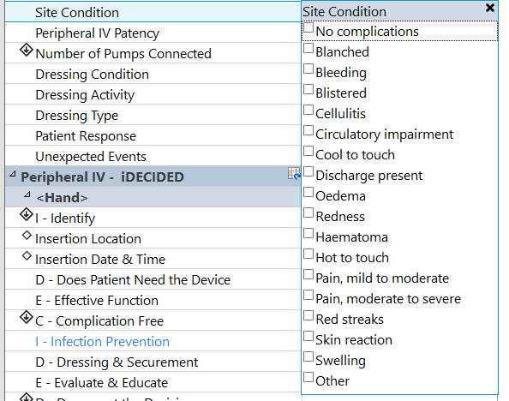
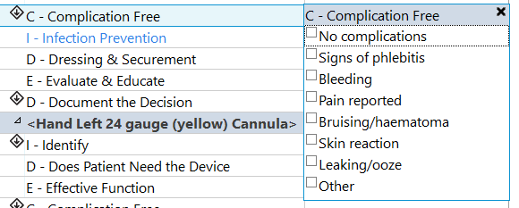
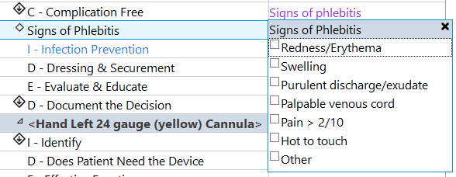
WHAT HAS CHANGED – SITE CONDITION > COMPLICATION FREE
Peripheral IV
Peripheral IV - iDECIDED

Slide 11


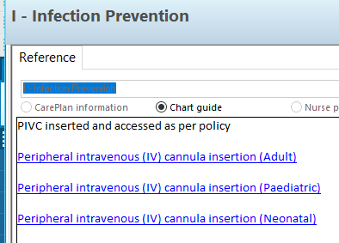
WHAT HAS CHANGED – INSERTED AS PER POLICY > INFECTION PREVENTION
Peripheral IV
Peripheral IV - iDECIDED

Slide 12
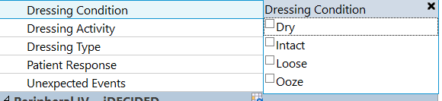
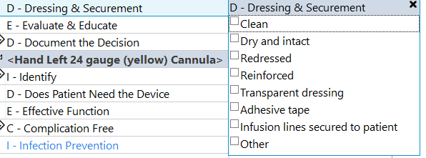

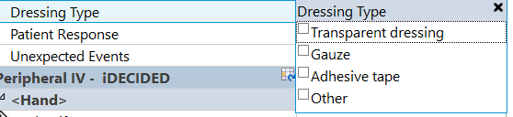
WHAT HAS CHANGED – DRESSING (MULTIPLE) > DRESSING & SECUREMENT
Peripheral IV
Peripheral IV - iDECIDED

Slide 13


WHAT HAS CHANGED – PATIENT RESPONSE > EDUCATE & EVALUATE
Peripheral IV
Peripheral IV - iDECIDED

Slide 14
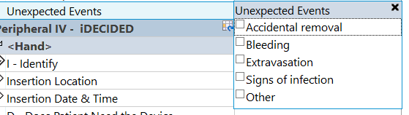

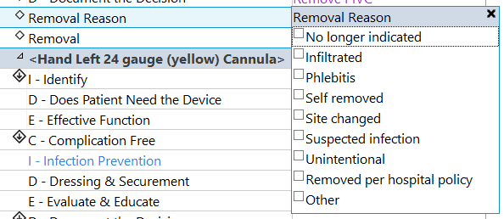
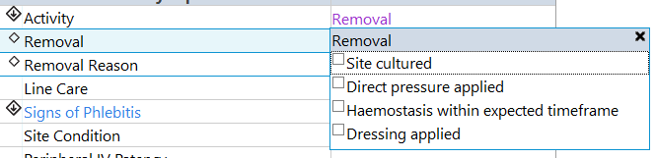
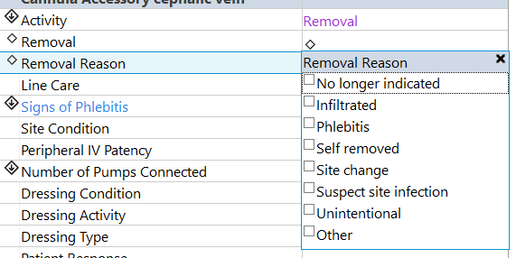
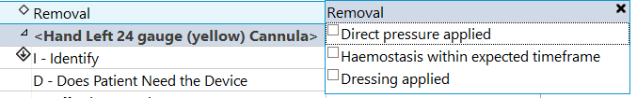
WHAT HAS CHANGED – DOCUMENT THE DECISION
Peripheral IV
Peripheral IV - iDECIDED

Slide 15
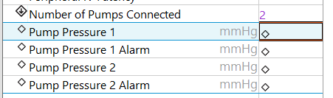
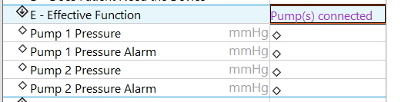
WHAT HAS CHANGED – NICU – PUMP PRESSURES & ALARMS
Peripheral IV
Peripheral IV - iDECIDED
Pump pressure alarms only showed for patients less than 1 year old
Pump pressure and alarms will only show for patients in a MCH NICU bed

Slide 16
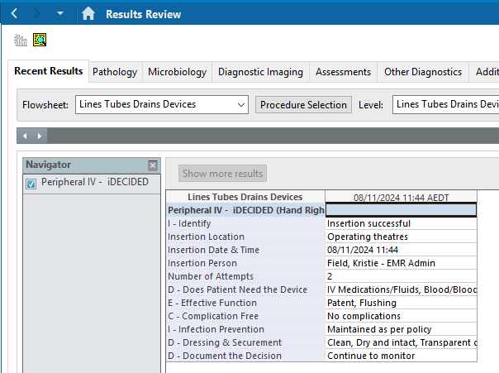
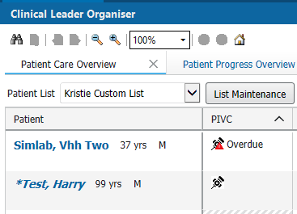
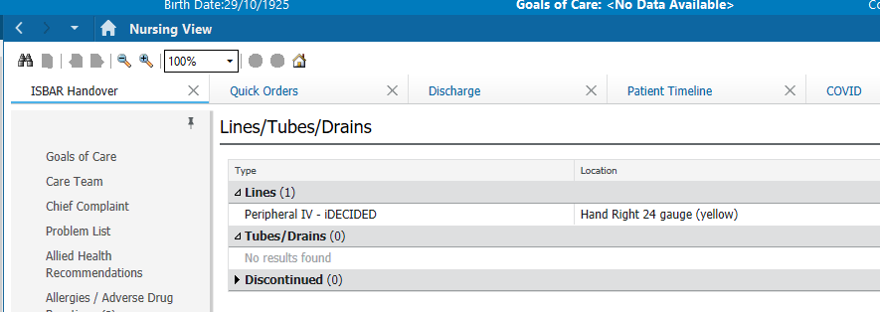

EMR VISIBILITY
Unchanged
CLO
Mpages
Results Review
New
LaunchPoint

Slide 17





INTERACTIVE VIEW - IVIEW
Everywhere that currently has Peripheral IV will now have
“Peripheral IV – iDECIDED”

Slide 18
TRANSITIONING FROM OLD TO NEW
Existing PIVCS (inserted or documented prior to this EMR change):
Continue documentation in the current dynamic group.
Discontinue when removed as per current process.
New PIVCs (inserted or documented after this EMR):
Use the new IDECIDED dynamic group.
Do NOT duplicate the same PIVCs.
Peripheral IV
Peripheral IV - iDECIDED
Planned Go Live: afternoon of Tuesday 19th Nov 2024

Slide 19
KEY MESSAGES
Similar content, different appearance
More streamlined and user friendly
Utilising evidenced based documentation tools
Promotes early removal of unnecessary PIVCs
Reduces complications
Transition from OLD to NEW documentation, do NOT duplicate

