Slide 1
Just say no to the ‘just-in-case’ cannula.

Slide 2



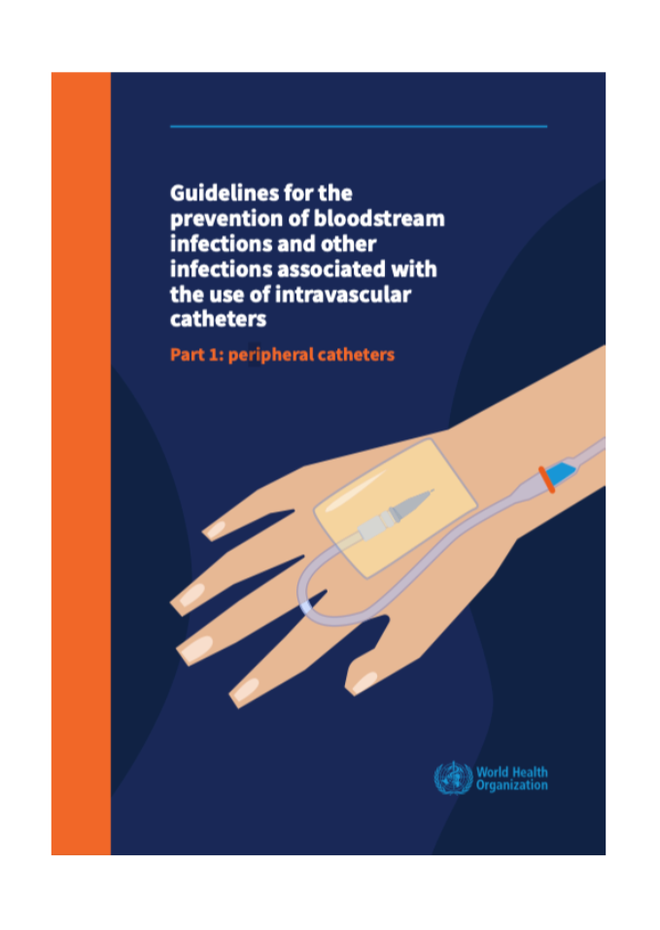
Background
Notes:
Management practices of peripheral intravenous catheters (PIVC) in emergency departments (EDs) are often suboptimal, despite available Australian Commission on Safety and Quality in Health Care (ACSQHC) and World Health Organization (WHO) standards based on quality evidence. Failure to adhere to best practice results in unnecessary cannulations, complications, and missed opportunities for quality and safe patient care.

Slide 3





Interventions aligned with ACSQHC Standards across 5 categories
Engagement
Clinical Guidelines & Policy
Environment &
Equipment Changes
Audit & Feedback
Education
Notes:
Key strategies include securing stakeholder support; aligning health service PIVC guidelines with national standards; simplifying electronic documentation; auditing intravenous trolleys; assessing staff knowledge; auditing PIVC documentation; analysing hospital-associated bacteraemia data; and providing regular feedback to stakeholders. Education is multi-faceted, including lanyard cards, daily reminders during safety briefings, use of patient case studies, and implementation of the I-DECIDED® tool. Site working groups and ED clinical champions modelled best practices

Slide 4
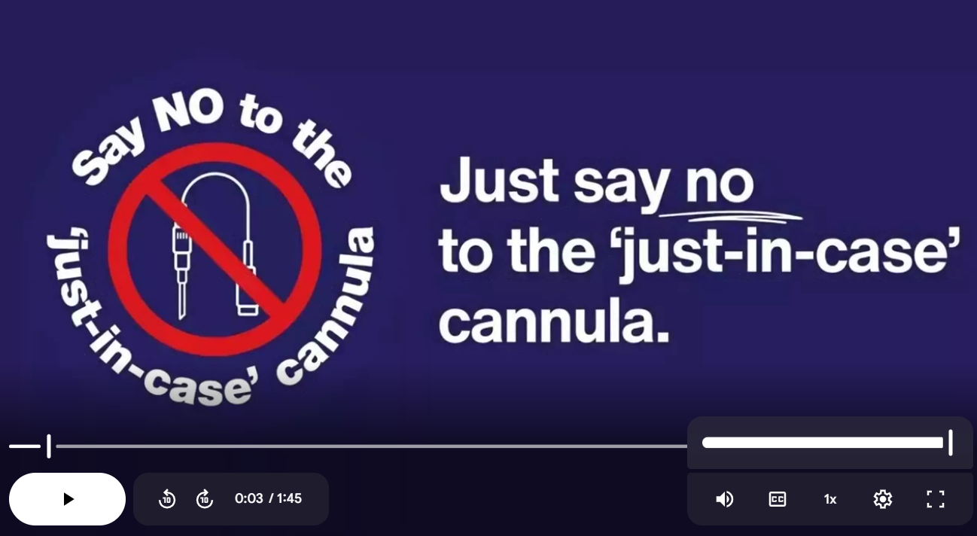
Notes:
Please click the image to play the video and test it out before your presentation.
Intervention video link
https://drive.google.com/file/d/1lp6q-h4IdT50bsEO37ay_J0qCIPVxw5D/view

Slide 5
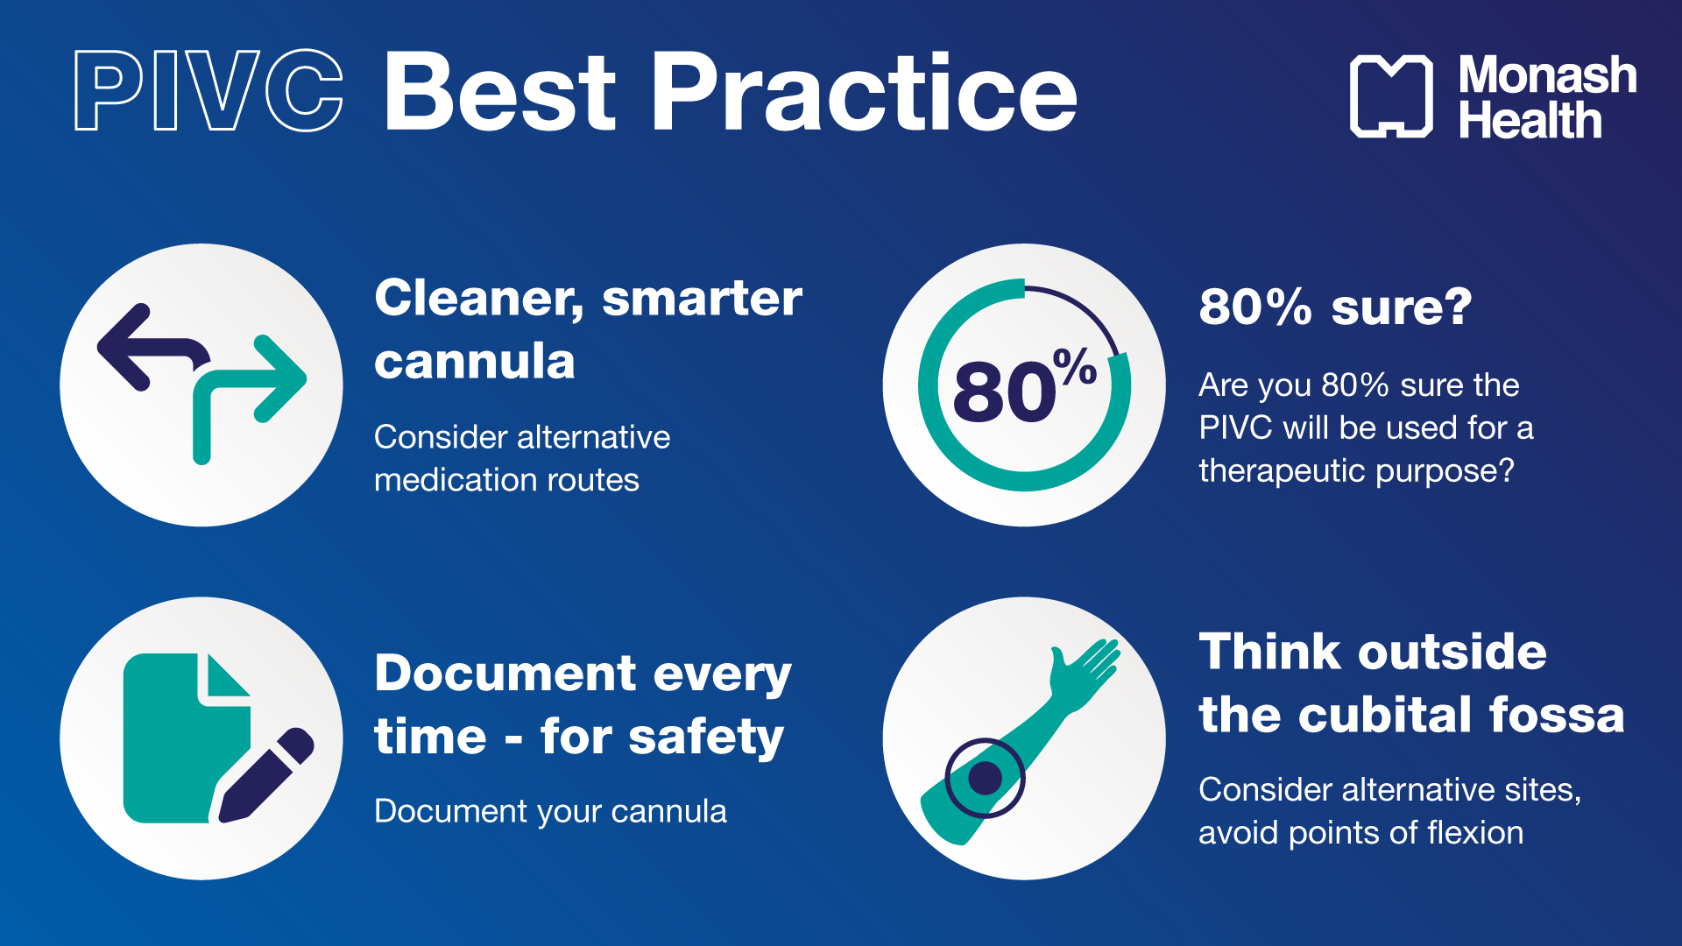
Notes:
Be 80% sure a cannula is needed. Consider alternatives. Document properly. Avoid flexion points. And talk to your patients.

Slide 6

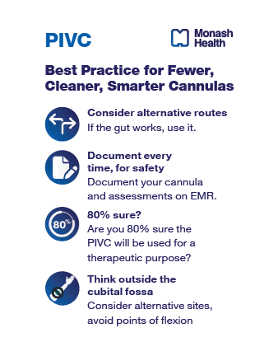

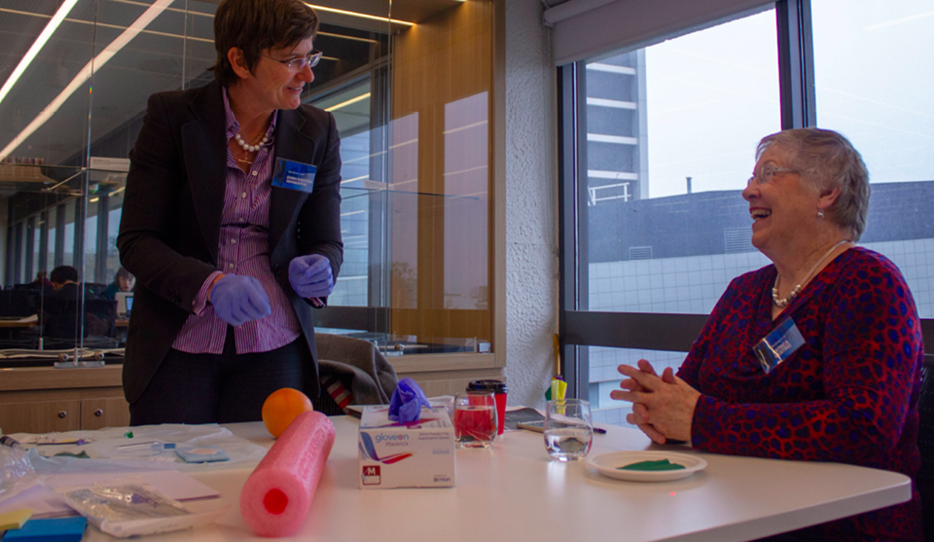
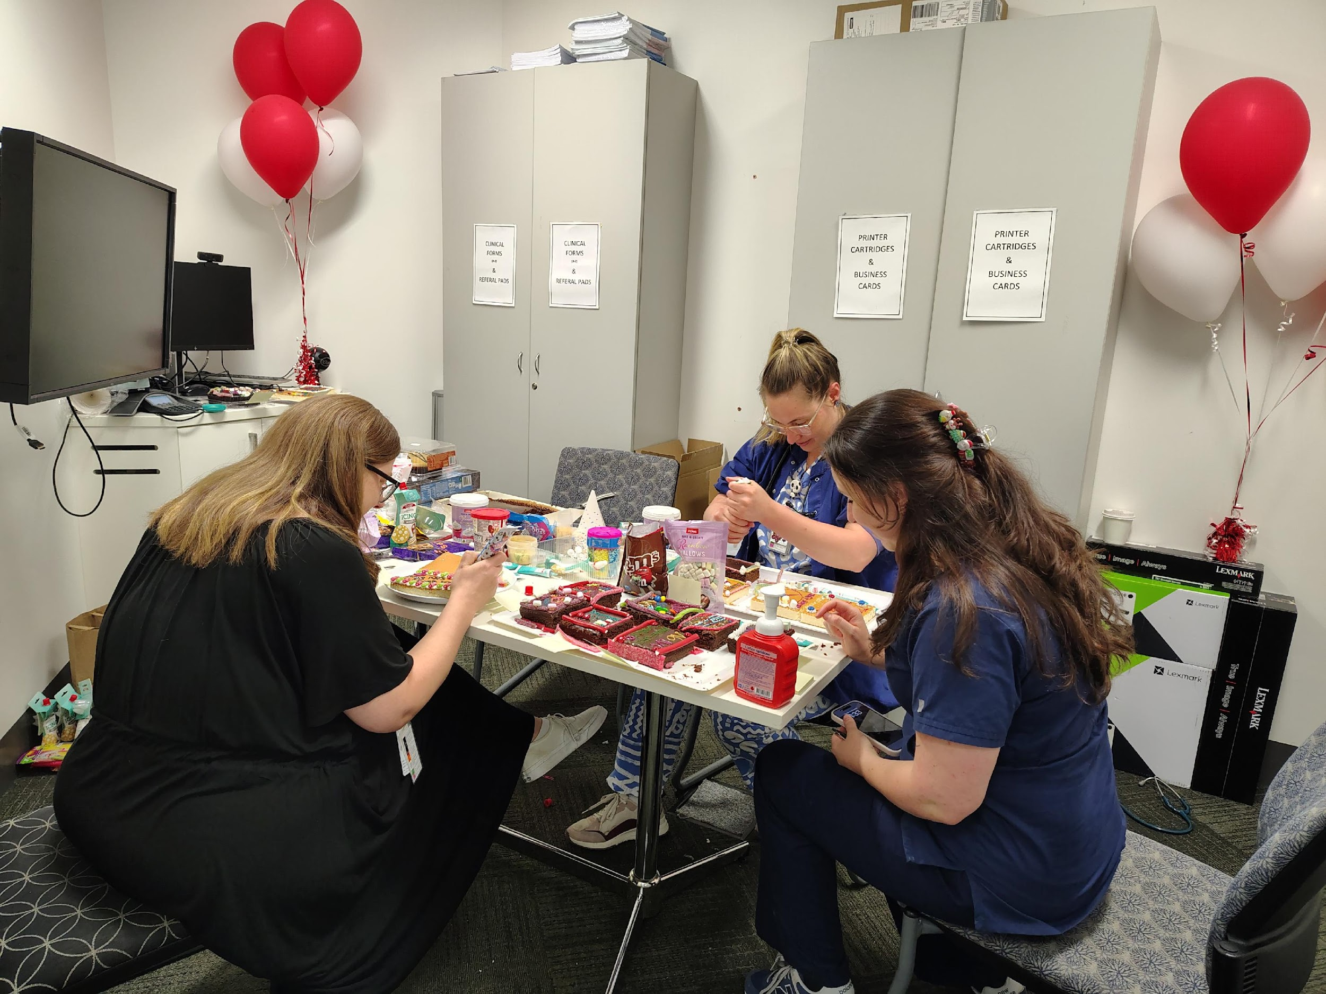

Engagement
Includes securing stakeholder support
Notes:
Interventions:
Organizational support
Implementation launch at each site
3. Logo design competition
4. Afternoon tea with promotional biscuits, cake decorations, staff BBQ, Twelve days of cannulation song, promotional pen, lollies, mouse pad, etc.

Slide 7



Clinical Guidelines & Policy
Aligning Health Service PIVC guidelines with national standards
Guideline mapping tool
Notes:
Interventions
Revise the local peripheral intravenous catheter (PIVC) guideline – CT & PIVC

Slide 8

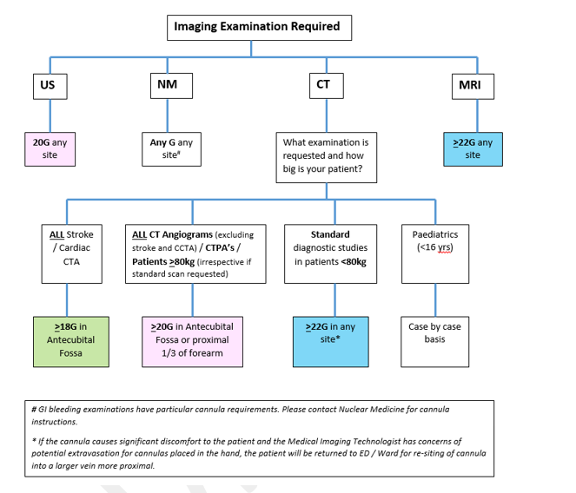

Slide 9
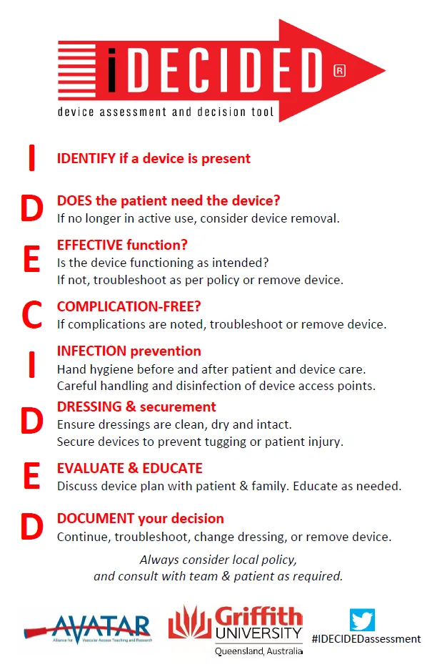
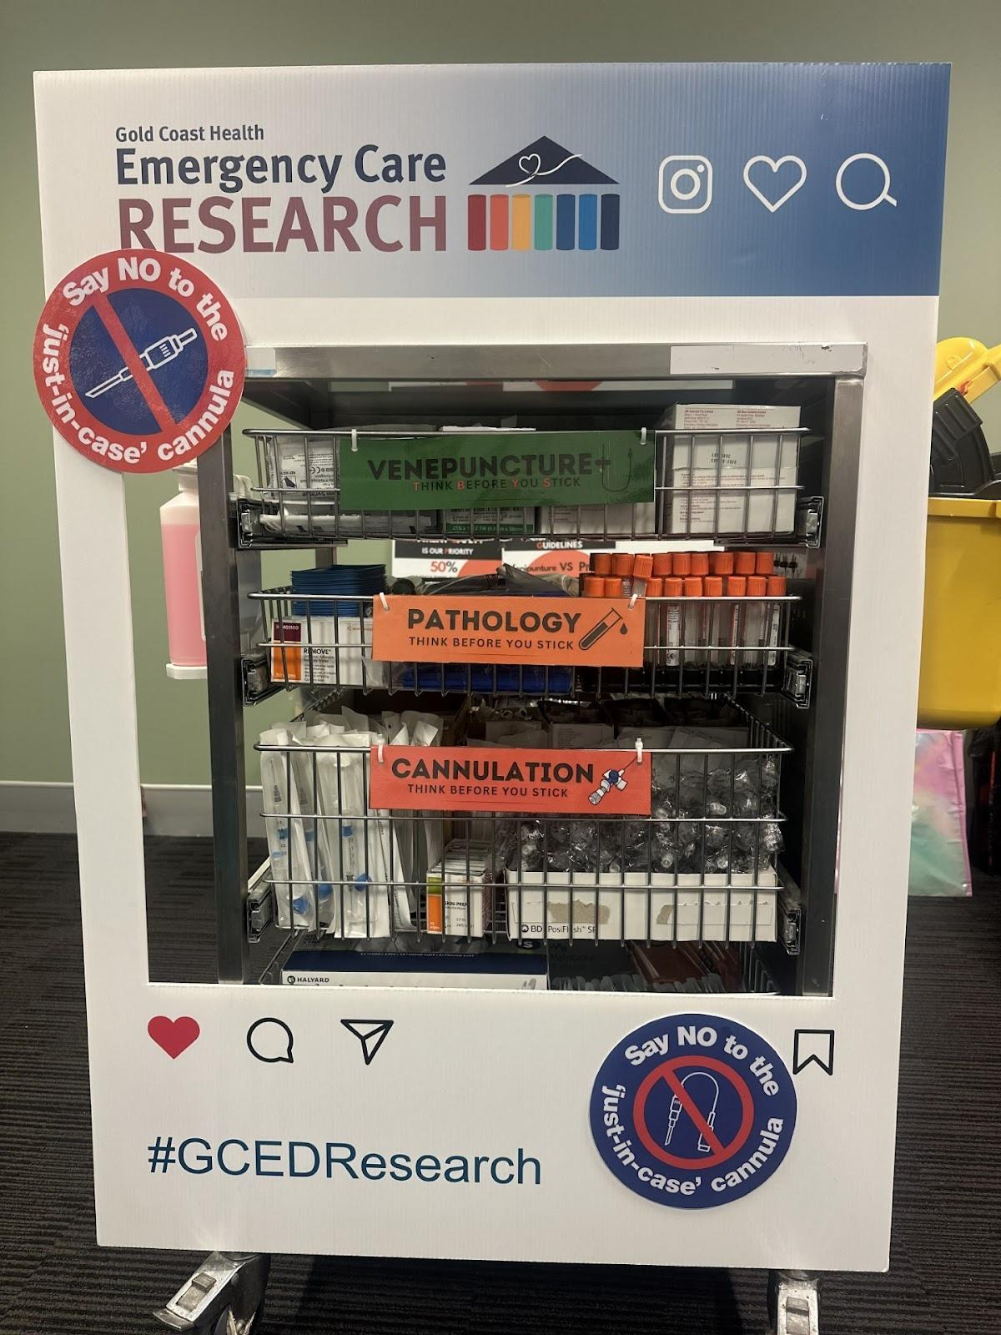
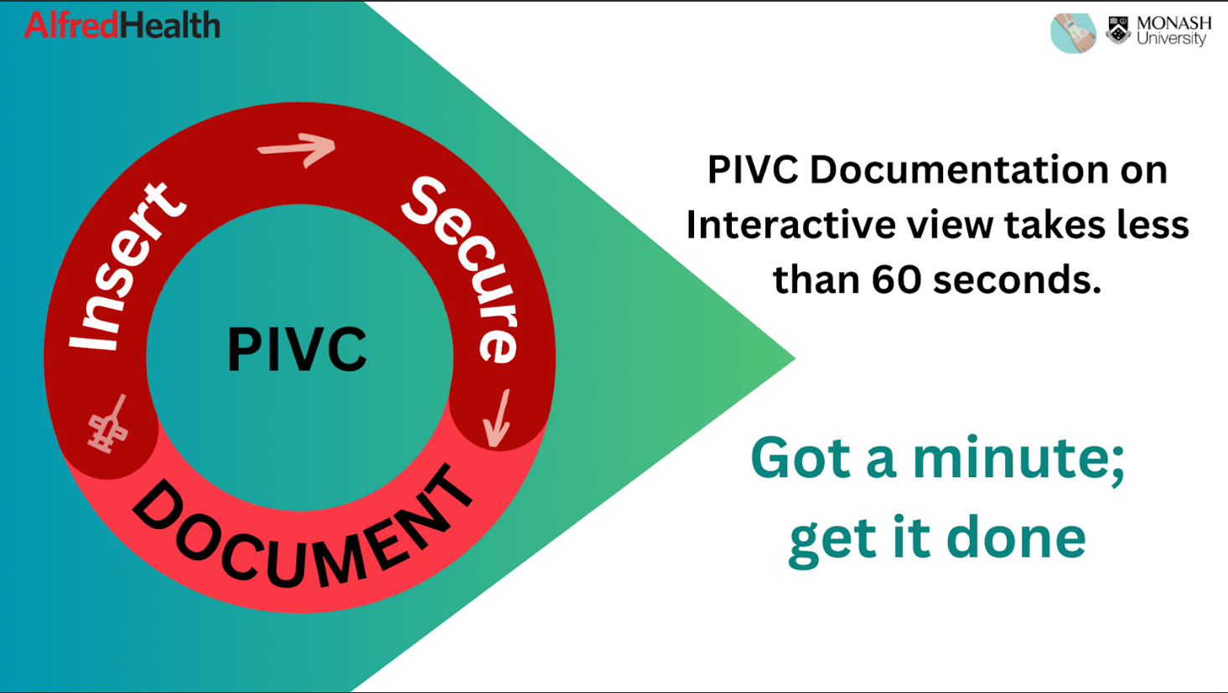
Environment & Equipment Changes
  Simplifying electronic documentation
  Audit and optimization of the intravenous (IV) trolley
Notes:
Interventions
1. EMR Changes: to simplify the PIVC documentation process
2. Audit and optimization of the intravenous (IV) trolley

Slide 10
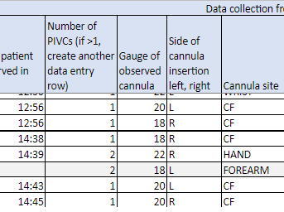
Audit and Feedback
Auditing intravenous trolleys
Assessing staff knowledge
Auditing PIVC documentation
Analysing hospital-associated bacteraemia data
Providing regular feedback to stakeholders
Notes:
Interventions
1. Pre and post-implementation survey of clinical staff to assess their intervention knowledge
2. PIVC documentation in EMR audit
3. Hospital-Associated (HA) Staphylococcus
aureus bacteraemia (SAB) data
4. Provide best practice PIVC-related information/statistics to medical directors and Nurse Unit Managers (NUMs)

Slide 11


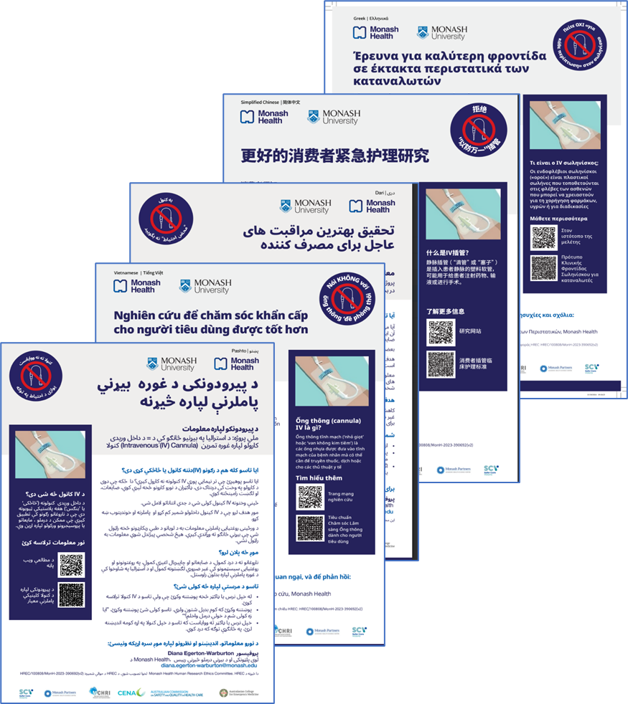
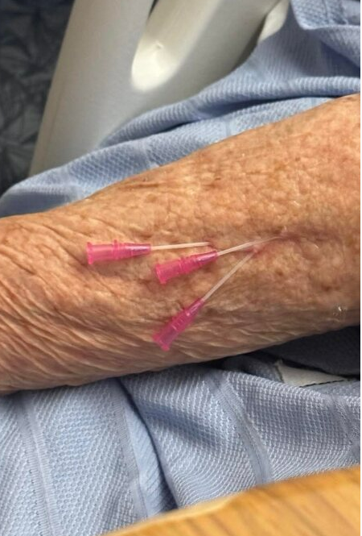
Education – multi-faceted, including
  Lanyard cards
  Daily reminders during safety briefings
  Use of patient case studies
  Implementation of the I-DECIDED® tool
  Site working groups & ED clinical champions modelling best practices
Notes:
Interventions
Hold clinician education sessions at each site
Lanyard cards, stickers, and badges
Ongoing PIVC credentials for clinicians
Remind clinical staff at daily briefing, Drs and nurses meetings, e.g., huddles
Include patient stories in the education sessions
Implement “I-DECIDED” tool in the PIVC best practice
6. Semi-structured focus groups
7. Site working group: clinical champions and researchers to model and promote the use of the intervention
8. Poster for patients
Consumer video: Created 60-second videos of patients sharing their PIVC experiences in EDs
Integrated these videos into clinician education to foster empathy, improve understanding of patient perspectives, and guide best practices in PIVC use. 3rd prize in Monash Health consumer participation experience poster competition.
Fiona https://youtu.be/OOZw4iD5NhQ?si=oPFoMmCFpnGw9at6

Slide 12
6. Sustainability
PIVC data dashboard
Integrating the cannula best practice audits into the PIVC Clinical Care Portfolio
Ongoing PIVC credentials and education for clinicians
Notes:
Interventions
1.PIVC data dashboard
2. Integrating the cannula best practice
audits into the PIVC Clinical Care
portfolio
3. Ongoing PIVC credentials and education for clinicians

