Slide 1
Just say no to the ‘just-in-case’ cannula.

Slide 2
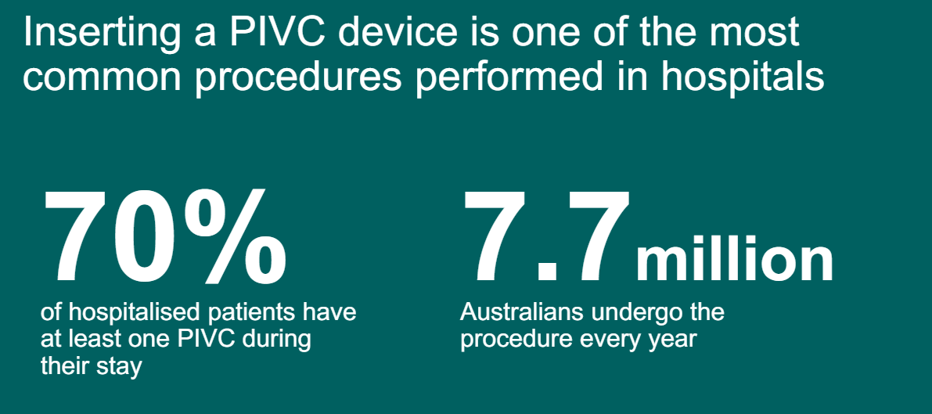
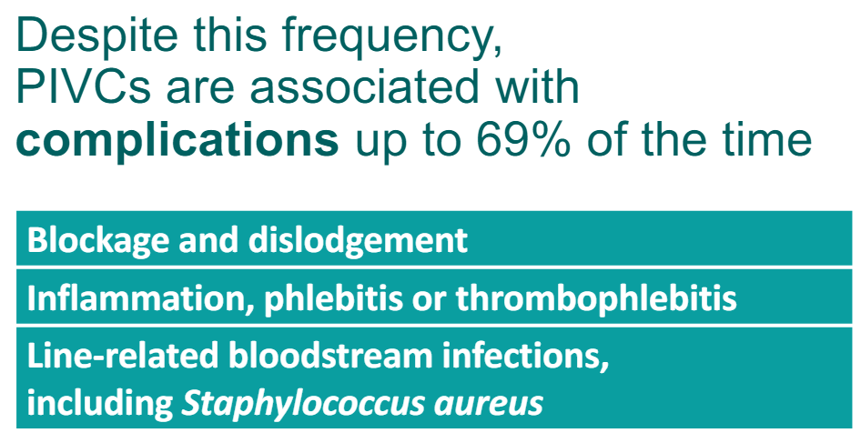
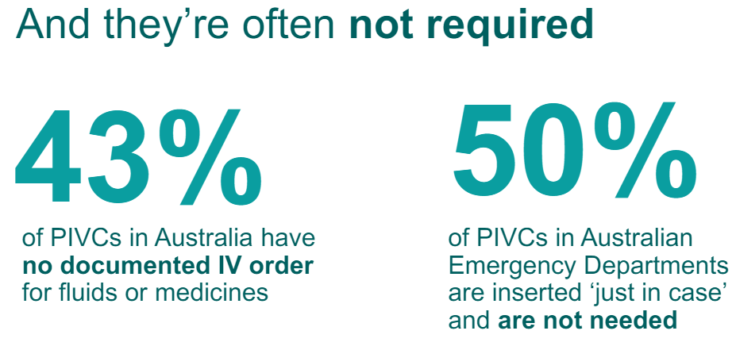
Total cost of unused cannula = A$305.9 million per year in Australia including:
Cost of insertion (equipment and staff)
Cost of complications such as Staphylococcus aureus bacteraemia and phlebitis
Patient-centred costs (lost patient productivity, infiltration, occlusion and dislodgement)

Slide 3
Aims & What we Ask of You
Reduce the number of unused cannulas inserted in ED
Be 80% sure that the PIVC will be used for a therapeutic purpose
Cleaner, smarter cannulas
Consider alternative routes to medication delivery, and venepuncture for pathology
Reduce insertions in the cubital fossa and over points of flexion
Consider alternative sites
Improve cannula documentation
Document the insertion and assessment of all cannulas you interact with

Slide 4
Aim of Reducing PIVC Insertions
Consumer impact
Less pain
Reduced infection risk
Encouraging shared decision making
Clinician impact
Less time spend cannulating & documenting
Empowerment and promotion of active clinical decision making
Organisation impact
Each SAB cost ~$38,000, and ~$48,000 if an MRSA infection occurs

Slide 5
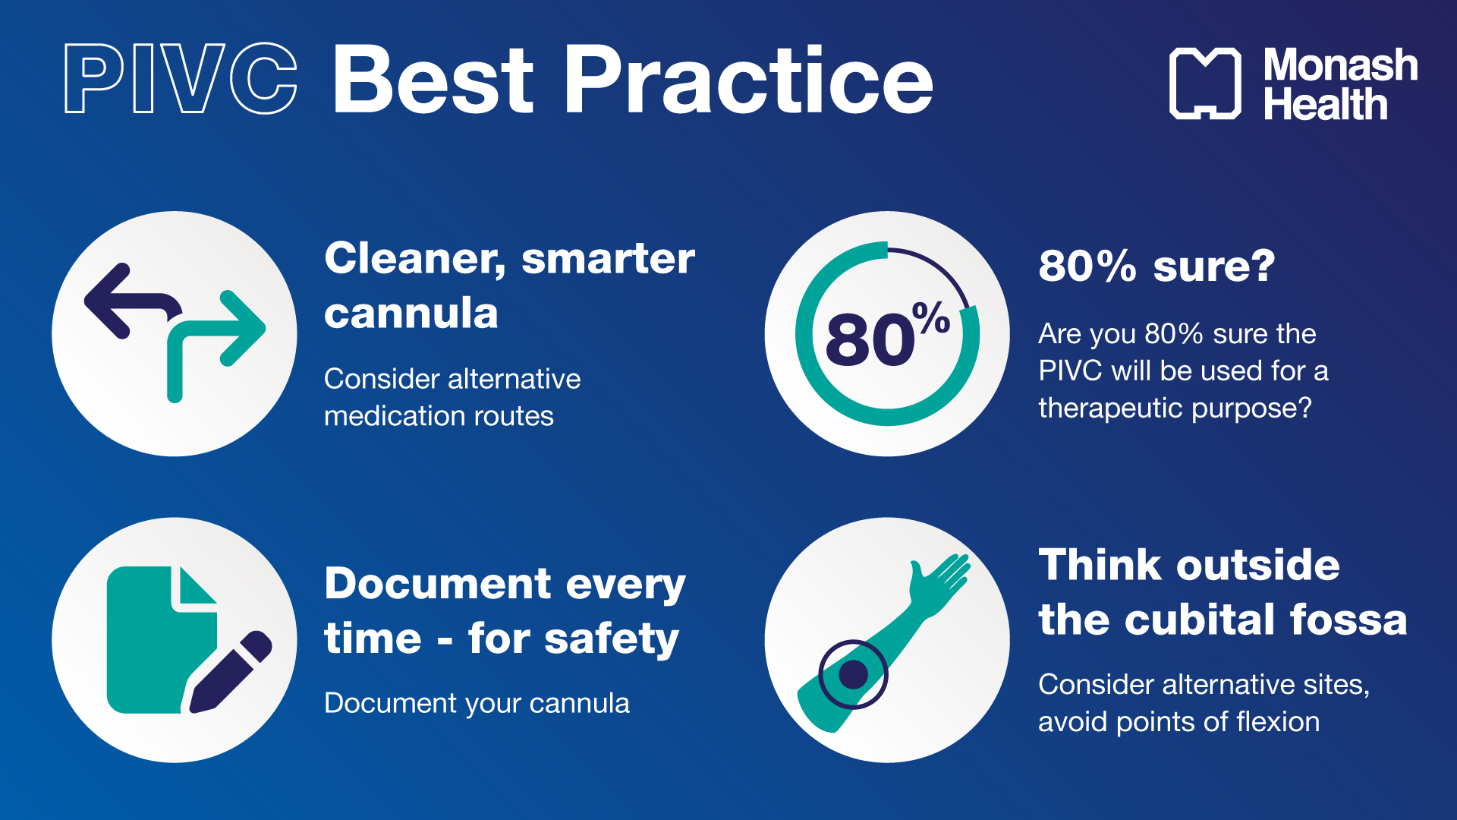

Slide 7
Insertion Indications
CONTRAINDICATION
Just in-case
Just to take blood
Serial pathology
Conditions where an unused PIVC insertion is appropriate
Unstable vital signs within 30 min of triage
High risk chest pain (i.e. abnormal ECG with chest pain)
Postictal state
True syncope
Estimated blood loss >500 mL and/or overt ongoing losses
High bleeding risk due to anticoagulation
History of oesophageal varices
Planned intention to use it for IV fluid, medication or contrast

Slide 9
Mythbusters
PIVC myth
Patients would rather a PIVC than multiple venipunctures
CT scans require an 18g in the cubital fossa
Fact
A study showed x2 venipunctures is prefered over an unused PIVC
A CT +C can be performed on a a well flushing 20g in the forearm, wrist or hand
Only a CT perfusion (stoke code) needs a cubital fossa cannula
Cubital fossa cannulas need to be removed within 24 hours

Slide 10


Slide 11
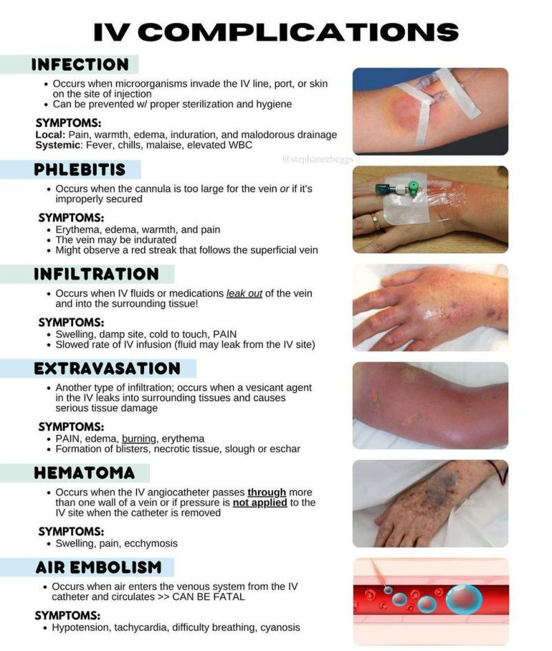
Assessment
Phlebitis | Infiltration | Extravasation
Inflammation of a vein | Occurs when fluid/medication leak out of vein and into surrounding tissue Eg, saline | Type of infiltration when IV fluid/medication leak into surrounding tissue and cause serious tissue damage Eg, adrenaline
Pain Erythema Warmth Redness Purulent discharge Palpable venous cord | Pain Swelling Ooze /fluid leakage Cool to touch | PAIN Oedema Burning Blistering Erythema Tissue necrosis/ sloughing

Slide 12

Game

Slide 13
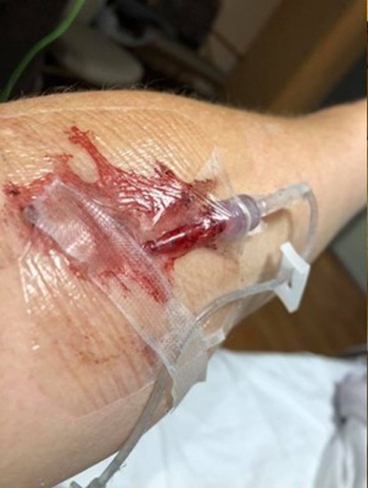

Slide 14
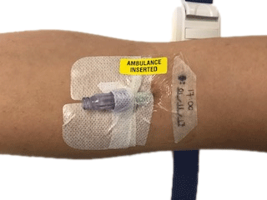

Slide 15
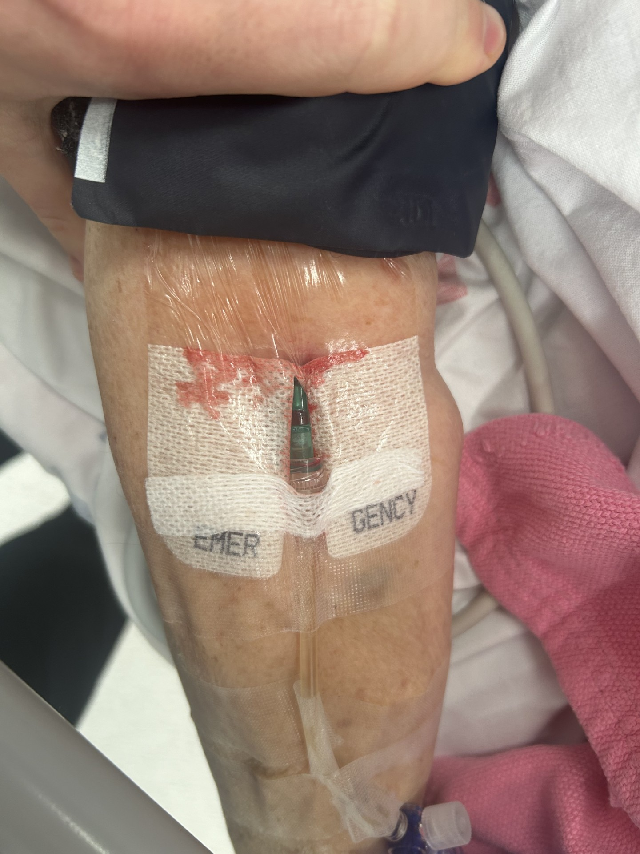

Slide 16
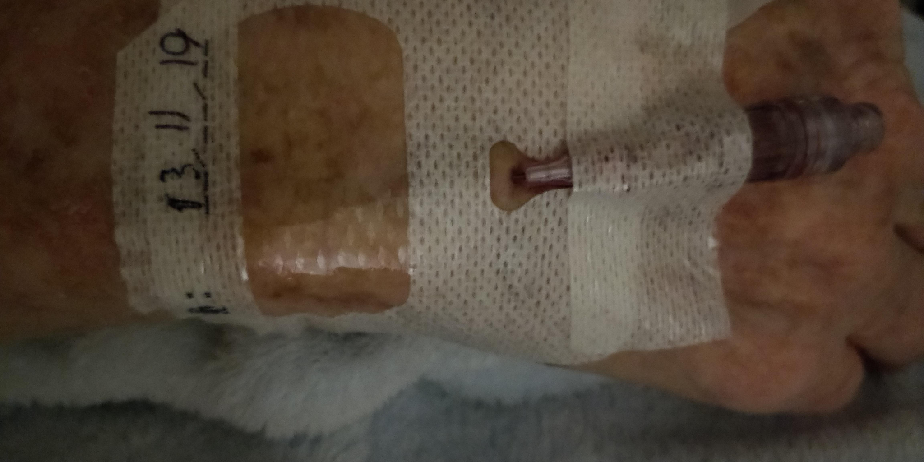

Slide 17
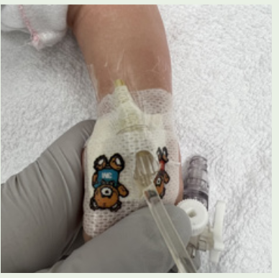

Slide 18
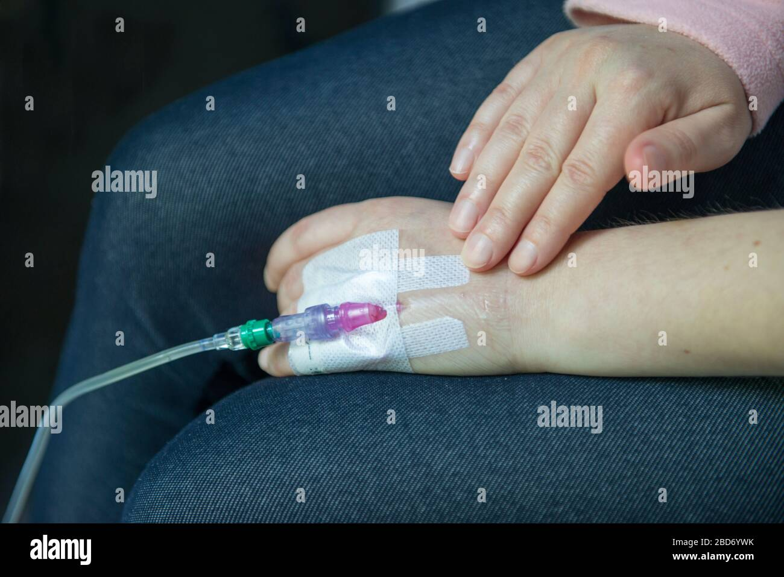

Slide 19
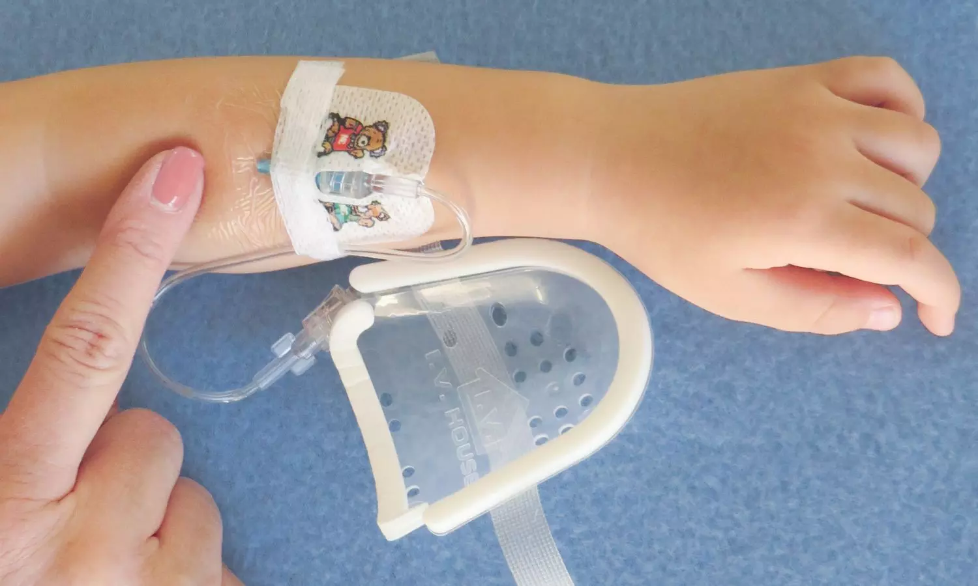

Slide 20
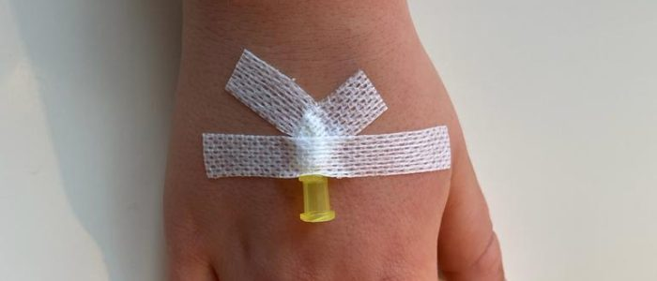
Notes:
Ensure that the proximal tip and area of skin around are always easily visible (Figure 5 below). Extravasation injuries can occur especially if the site is not readily accessible for regular nursing checks

Slide 21
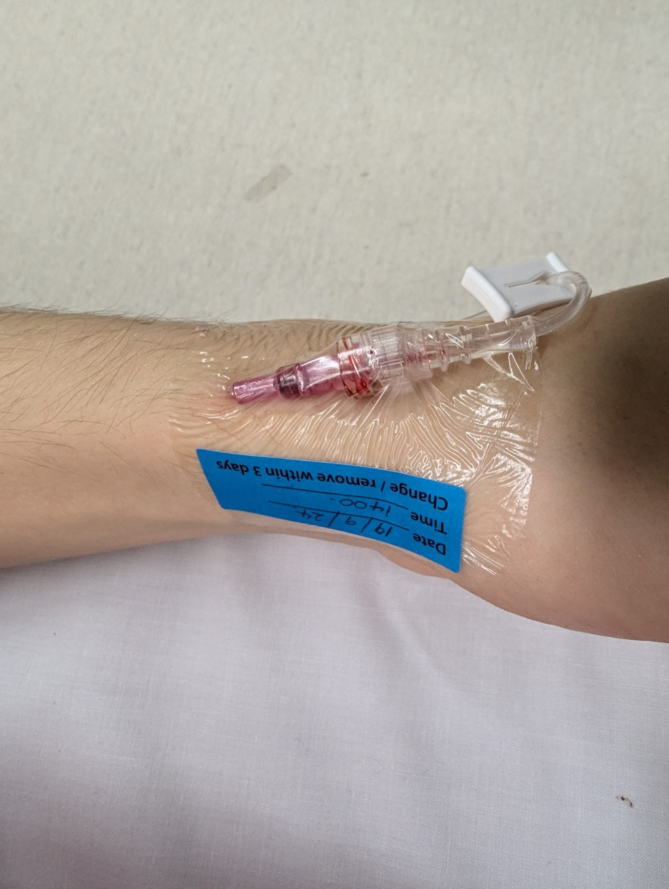

Slide 23
Real Life Stories
An AV PIVC stayed in for 4 days and caused a SAB & sepsis.
Instead of the patient being discharged home, they went to ICU and Kingston rehab due to a PIVC infection.
PIVC remained in for 3 days. ?Not used or needed.
PIVC infiltration caused SAB infection and partially occlusive thrombus.
Required PICC line to treat the PIVC line issue
Increased LOS by 3 days, and 2 weeks HITH treatment.
Poor infection prevention at the time of cannula insertion caused a SAB within 2 days.
The patient is a nurse and watched the procedure be performed in a non-aseptic manner. She also complained of pain and erythema at the site which was ignored for a day.

Slide 24
Real Life Stories
Patient was admitted on the ward for 4 days, then deteriorated into sepsis, and showed positive blood cultures for MSSA.
Had multiple PIVC sites over those 4 days with poor documentation of PIVC insertion, assessments and removals.
Poor PIVC documentation making it difficult to trace if a PIVC is responsible for the infection - but almost certainly was the cause of SAB.
“I was told they are taking police bloods as it's a motor vehicle accident. They didn't ask for choice of arm not offered to do it behind my hand. My right hand cubital fossa was used.It took longer than drawing a blood sample and it was extremely uncomfortable. When I looked I already had a cannula put it. I was out of ER in 3-4 hours after a CT of my neck. My discomfort was I wasn't asked my preference, nor consent or mentioned about cannula. I was well oriented, responsive and have high medical literacy.”

Slide 25


Slide 26
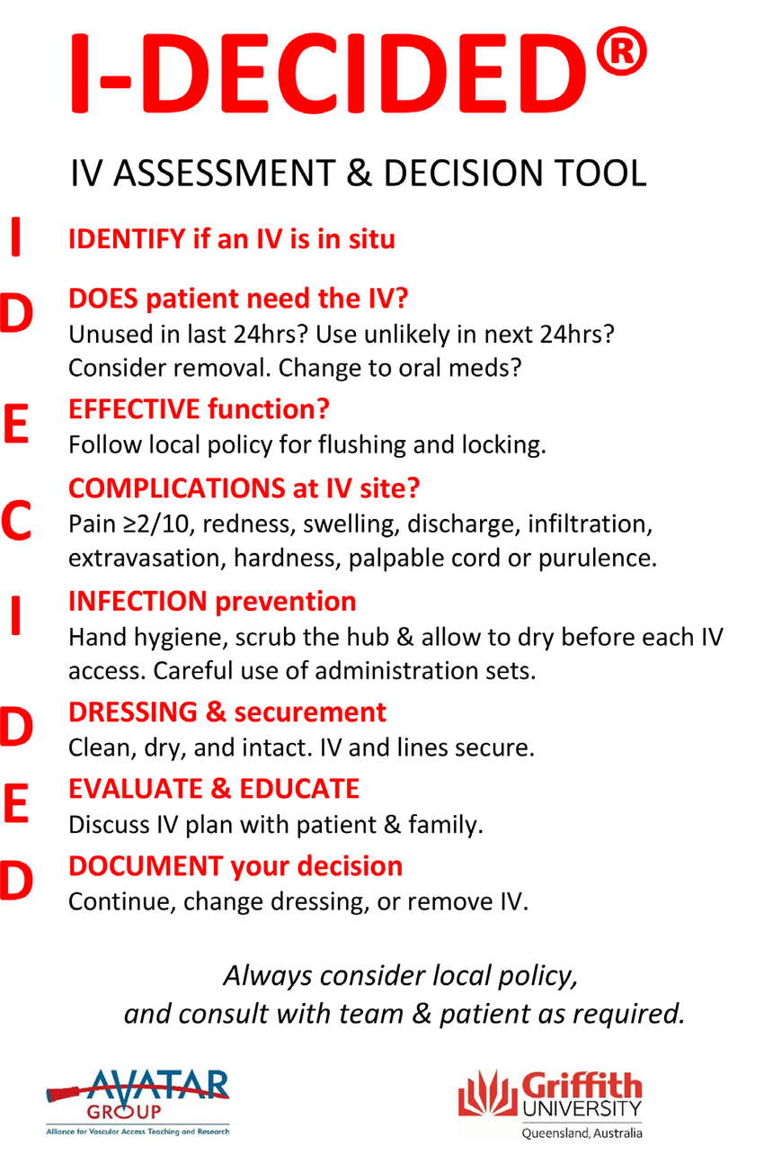
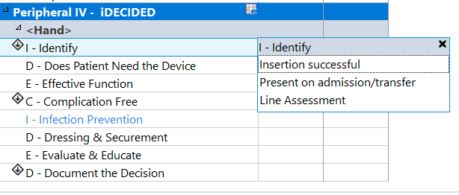

Slide 27
Complication Free
-No complications
-Sign of phlebitis >
-Bleeding/blood present
-Patient report of pain
-Bruising/Hematoma
-Skin reaction
-Swelling
-Leaking/Ooze
-Other
Dressing and securement
-Clean, dry & intact
-Re-dressed
-Reinforced
-Transparent dressing
-Infusion lines secured to patient
Evaluate and educate
-PIVC care discussed with patient
-PIVC care discussed with family
-Not appropriate
Identify
-Insert new site
-Present on admission
-Line Assessment
>Sign of phlebitis
-Pain >2/10
-Redness/erythema
-Swelling
-Palpable venous cord
-Purulent discharge /exudate
-Hot to touch
-Other
Document your Decision
-Continue to monitor
-Remove IV >
Does the patient need the device
-Yes- being used
-Yes- needed but not being used
-No- consider removal
>Removal reason
-No longer indicated
-Infiltrated
-Phlebitis
-Self removed
-Site changed
-Suspected site infection
-Unintentional
Effective function
-Patent
-Flushed
-Aspirated
-Not aspirating
-Occluded
Infection prevention
-Yes
-No

