Slide 1
Just say no to the ‘just-in-case’ cannula.

Slide 2
PIVC DOCUMENTATION
ED IN-SERVICE
INDEX

Slide 3
WHY IS DOCUMENTATION IMPORTANT?
It is a requirement to document all procedures, particularly invasive procedures, performed on a patient.
Without accurate document PIVCs can be left for extended periods leading to SAB and other infections
Once PIVC documentation more accurately reflects real insertion rates, the major “just say NO to the ‘just in case’ cannula” project will commence with an accurate baseline

Slide 4

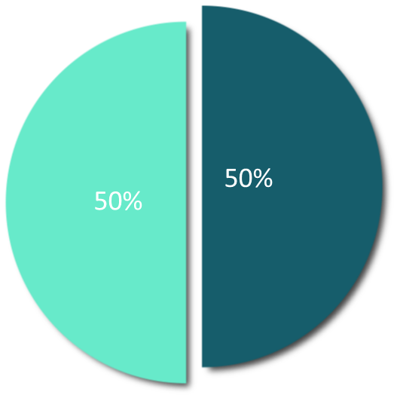
WHAT IS THE CURRENT DOCUMENTATION RATE?
Snapshot of PIVC documentation data
April 2024
50%
of PIVC insertions were not documented

Slide 5
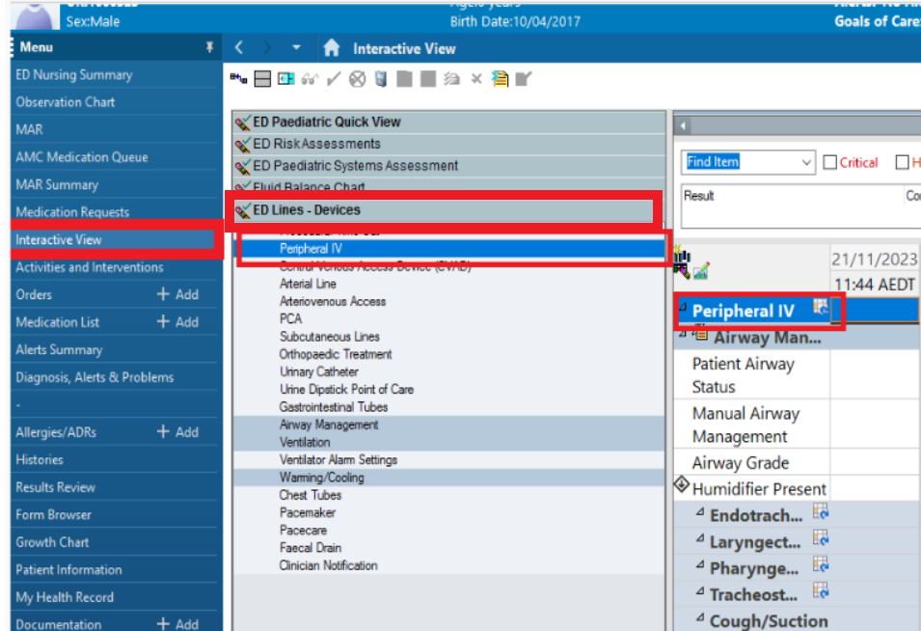

How to document a PIVC insertion?

Slide 6
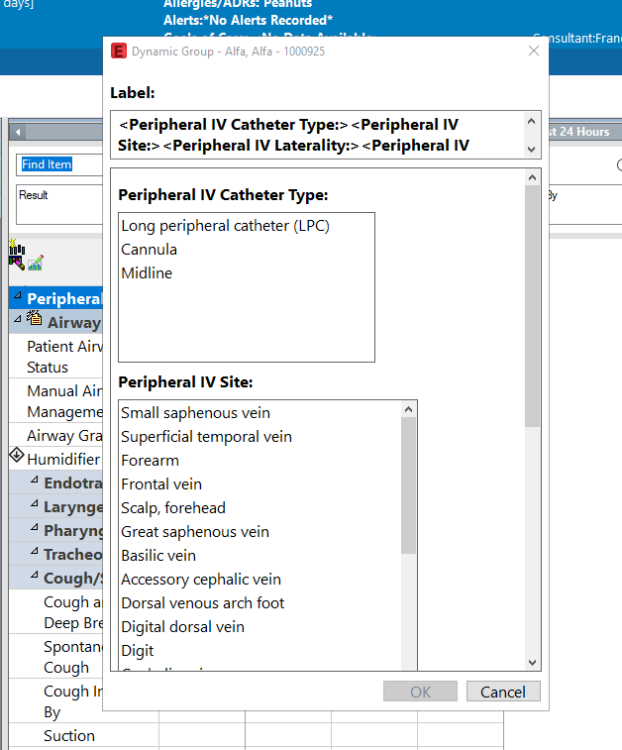
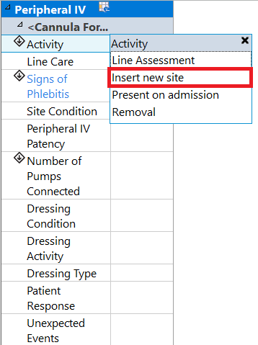
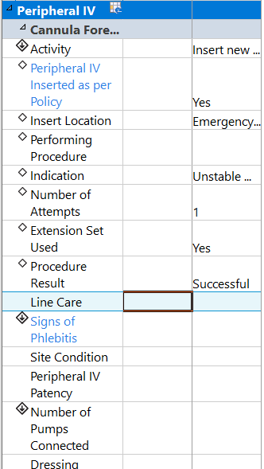
Continue scrolling to complete all fields

Slide 7
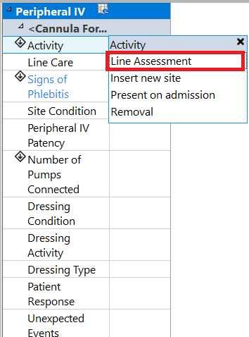
What if I didn’t put it in?
It is still important to document a PIVC, even if you weren't the one to put it
Open a new dynamic group noting the size and location, then select ‘line assessment’
Complete all other fields as appropriate

Slide 8
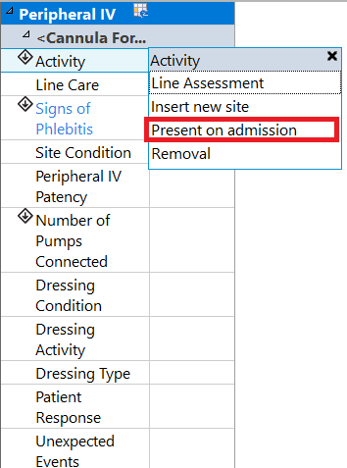
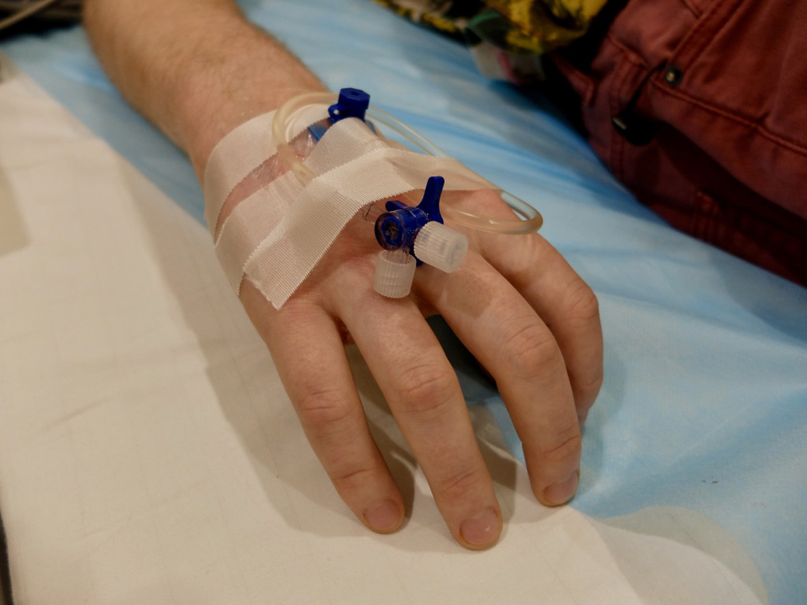

What if it’s an AV cannula?
An AV IVC should still be documented by opening a new dynamic group, noting size and location, documenting it as ‘present on admission’
Complete all other fields as appropriate

Slide 9
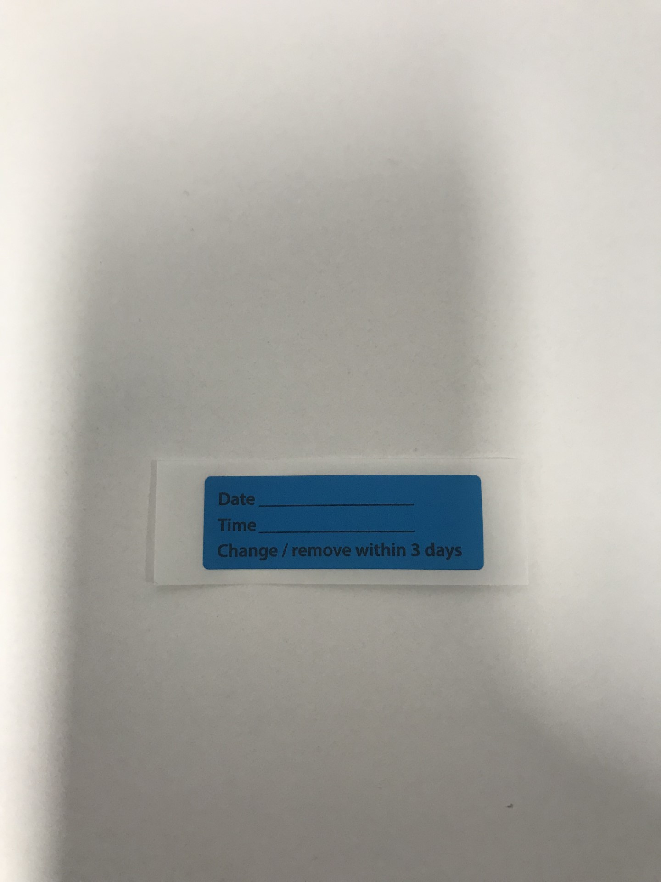
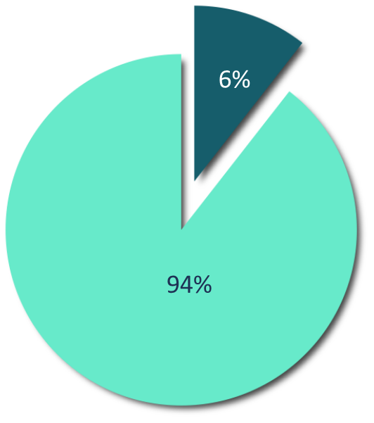
Labelling PIVC
Current rate of labeling PIVCs at the site is approximately 8%
This is important to ensure they don’t stay in longer than 72 hours(ED) or 24 hours (AV and cubital fossa) or as per hospital policy
Only
6%
of PIVC has date of insertion present at cannula site

