Slide 1

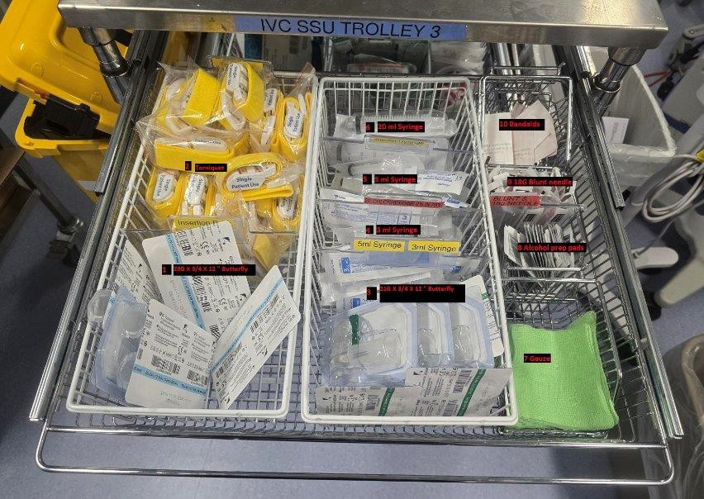
Venepuncture Trolley Set-Up

Slide 2
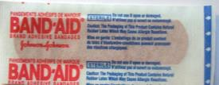
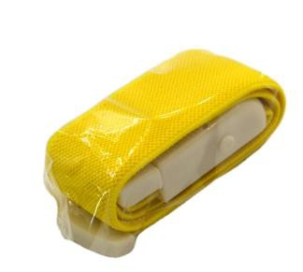
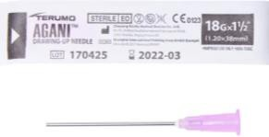

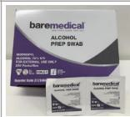
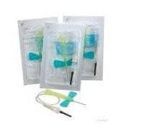
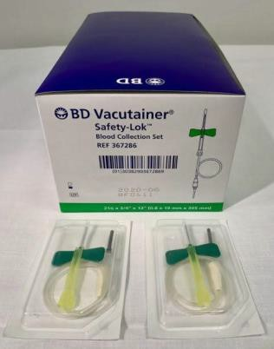
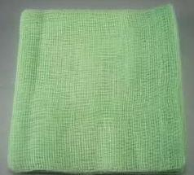
TOP DRAWER
Torniquets
20ml Syringe
Bandaids
5ml Syringe
18G Blunt Needle
18G Sharp Needle
Alcohol Prep Pads
23G x 1/4 x 12"
Butterfly
21G x 1/4 x12"
Butterfly
Gauze
FRONT

Slide 3
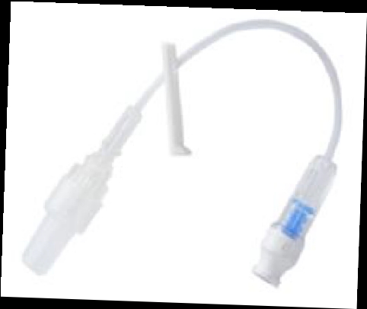
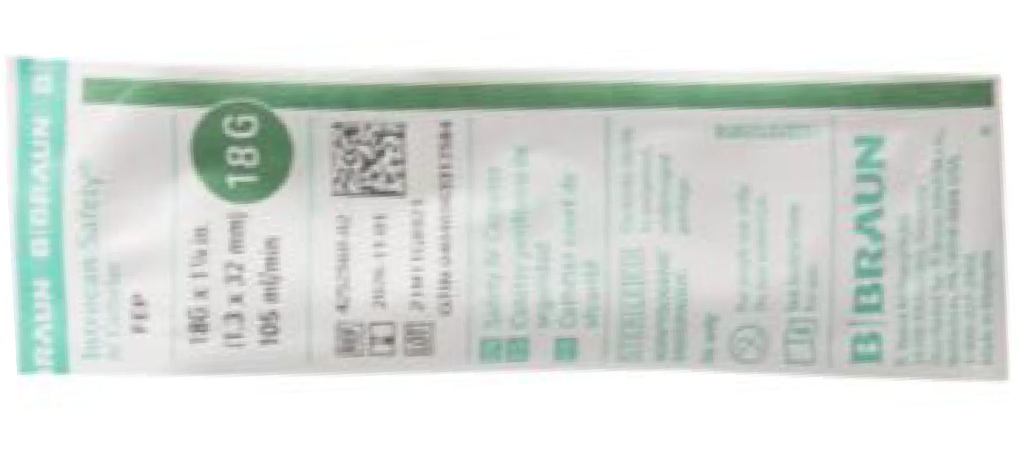
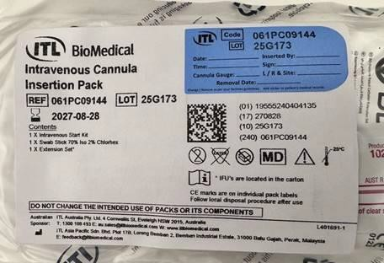
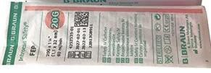
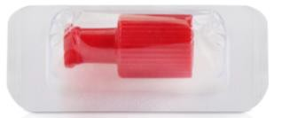
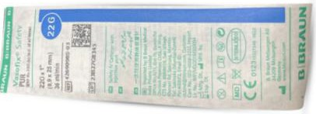
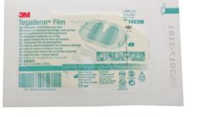
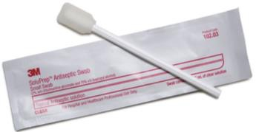
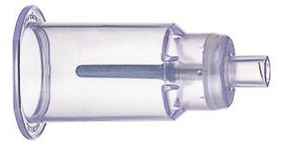
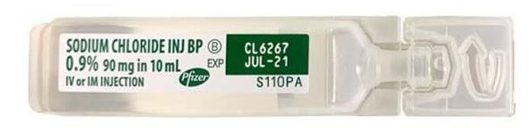
MIDDLE DRAWER
Cannula Packs
18G Green Cannula
J. Loop
20G Pink Cannula
Red stopper
22G Blue Cannula
Tegaderm
Swab Sticks
10ml Syringe
Sodium Chloride 10ml
Vacutainer
FRONT

Slide 4
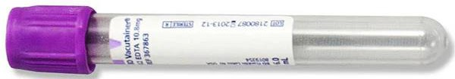
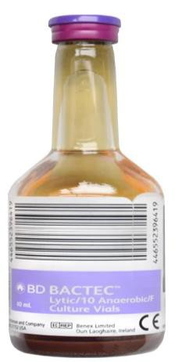

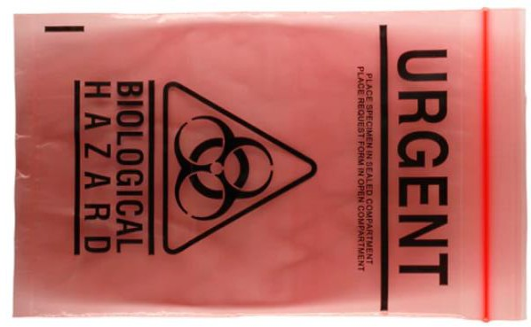


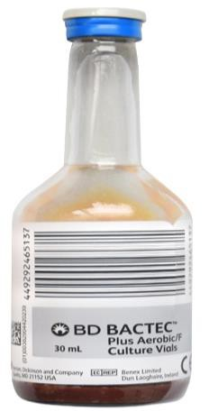
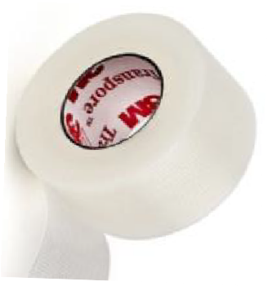
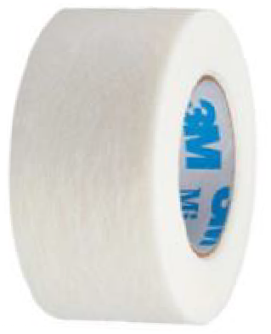

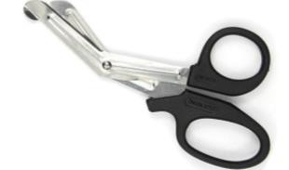
BOTTOM DRAWER
Big Purple Blood Tube
Size 6-8.5 Sterile Gloves
Purple Blood Culture Tubes
Yellow Blood Tube
Red pathology bag
Purple Blood Tube
Grey/Blue Blood Culture Tubes
Blue Blood Tube
Scissors Tapes
VBG Syringe
FRONT

