Slide 1
Just say no to the ‘just-in-case’ cannula.

Slide 2
Huddle Messages

Slide 3
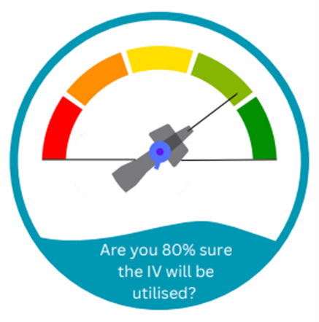
QUALITY STATEMENT 1: ASSESS INTRAVENOUS ACCESS NEEDS
80% sure your patient needs a PIVC for a therapeutic purpose.
Think: what will this PIVC be used for?
No change to appropriately unused cannula (eg: Code stroke, trauma call)
* Australian Commission for Safety and Quality in Healthcare

Slide 4
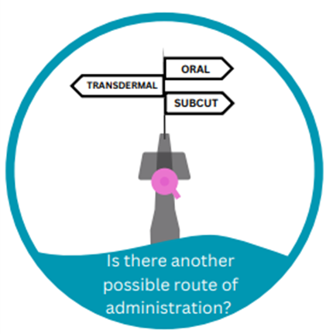

QUALITY STATEMENT 1: ASSESS INTRAVENOUS ACCESS NEEDS
* Australian Commission for Safety and Quality in Healthcare

Slide 5

QUALITY STATEMENT 2: INFORM AND PARTNER WITH PATIENTS
Tell your patient why you are inserting a PIVC, and ask them to inform you of any concerns
* Australian Commission for Safety and Quality in Healthcare

Slide 6
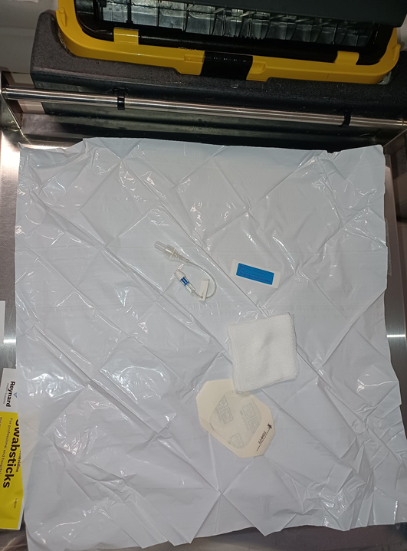
QUALITY STATEMENT 3: ENSURE COMPETENCY
Ensure your training for PIVC insertion and aseptic no - touch technique is up to date
* Australian Commission for Safety and Quality in Healthcare

Slide 7
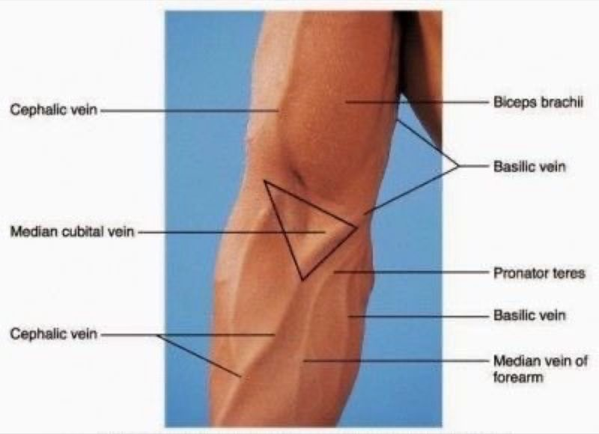
QUALITY STATEMENT 4: CHOOSE THE RIGHT INSERTION SITE AND PIVC
Cubital Fossa | Other sites
Resus | Medications
Large bolus fluids | Fluids
Code stroke/CTCA
* Australian Commission for Safety and Quality in Healthcare

Slide 8

QUALITY STATEMENT 4: CHOOSE THE RIGHT INSERTION SITE
Avoid points of flexion
Forearm/hand is preferred site by patients and recommended*
* Australian Commission for Safety and Quality in Healthcare

Slide 9


QUALITY STATEMENT 4: CHOOSE THE RIGHT INSERTION SITE
DRUG CHART: Antibiotics
A 22 gauge PIVC should suffice
Size: Colour
* Australian Commission for Safety and Quality in Healthcare

Slide 10

QUALITY STATEMENT 5: MAXIMISE FIRST INSERTION SUCCESS
Ask your patient if they have a history of difficult IV access
Review the difficult intravenous access procedure in the PIVC insertion, assessment and management policy
Australian Commission for Safety and Quality in Healthcare

Slide 11

QUALITY STATEMENT 5: MAXIMISE FIRST INSERTION SUCCESS
Make sure you feel confident of first insertion success or escalate to a senior clinician
Use long 18G PIVC for ultrasound insertions
* Australian Commission for Safety and Quality in Healthcare

Slide 12
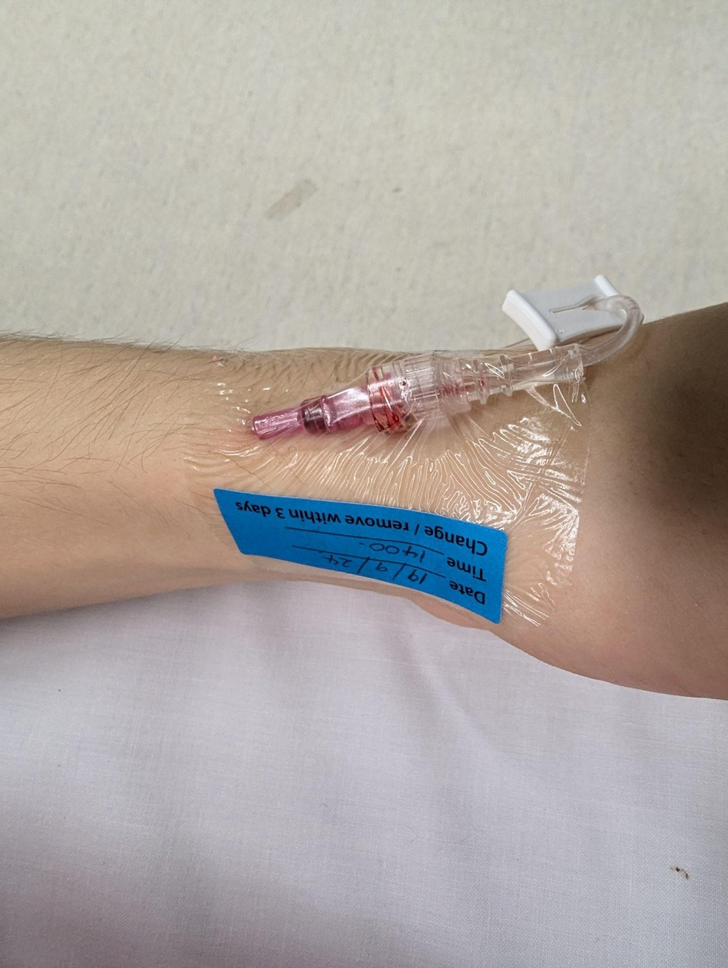

QUALITY STATEMENT 6: INSERT AND SECURE
Aseptic technique
Secured and labelled
  remove hair
  transparent dressing
  insertion point visible
  date of insertion
Date of insertion: _/_/_
Time of insertion: - : -
* Australian Commission for Safety and Quality in Healthcare

Slide 13

QUALITY STATEMENT 7: DOCUMENT DECISIONS AND CARE
Insertion is documented
Assessed minimum 8 hourly (and documented)
Removal is documented
Australian Commission for Safety and Quality in Healthcare

Slide 14

QUALITY STATEMENT 8: ROUTINE USE: INSPECT, ACCESS, FLUSH
Scrub the hub vigorously and allow to air dry
If a line is disconnected, it can’t be reconnected - a new line needs to be commenced
Pain is one of the best indicators of impending cannula failure
* Australian Commission for Safety and Quality in Healthcare

Slide 15
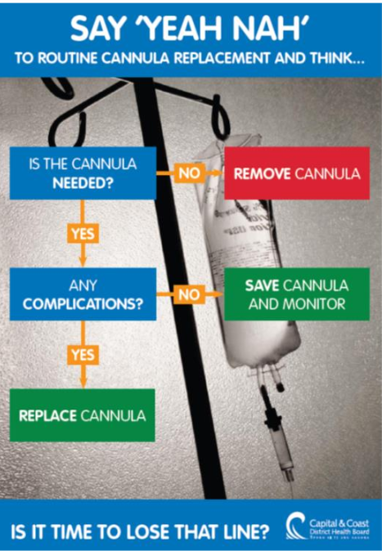
QUALITY STATEMENT 9: REVIEW ONGOING NEED
At the start of your shift think: What are we using this PIVC for?
Before your patient goes to the ward - do they still need their PIVC?
* Australian Commission for Safety and Quality in Healthcare

Slide 16


